Slide 1
NATURAL DISASTERS
Составитель: Юсупова З. Г.

Slide 2
RAINY
SUNNY
CLOUDY
FOGGY
WEATHER
BRAIGHT
WINDY
WARM

Slide 3
LOVELY FOR
OUTING
INDOORS
SUNNY BRIGHT WARM
RAINY CLOUDY WINDY FOGGY

Slide 4
Поставьте результат в лист оценивания.

Slide 5
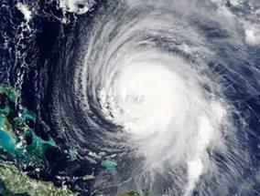
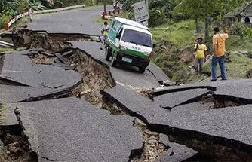
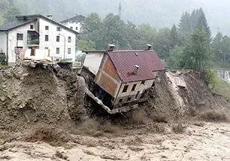
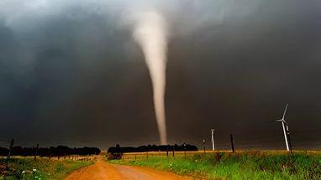
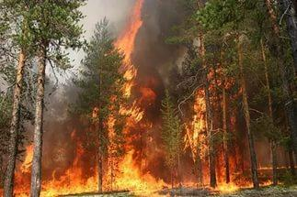
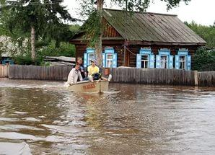
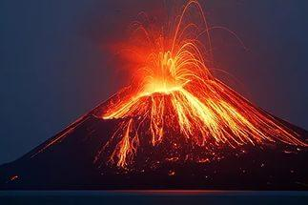
NATURAL DISASTERS.

Slide 6
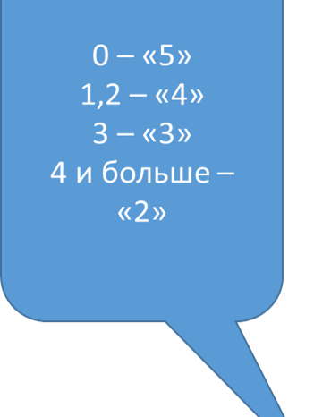
НАПИШИТЕ ПО-АНГЛИЙСКИ
tsunami
Цунами вулкан оползень ураган торнадо землетрясение лесные пожары наводнение
Tsunami volcano landslide hurricane tornado earthquake wildfires flood
Проверь работу товарища. Оцени его труд.

Slide 7
Закончить предложения.
There are many volcanoes in … Many … occur in the Pacific Ocean A lot of wildfires happen in … . Many … happen in our place. Tornadoes and hurricanes happen in the … .

Slide 8
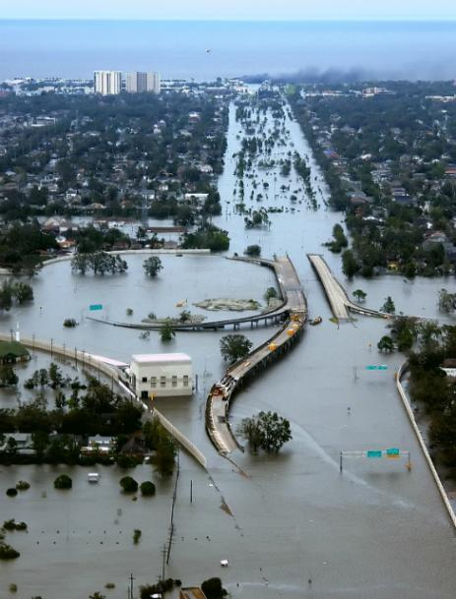
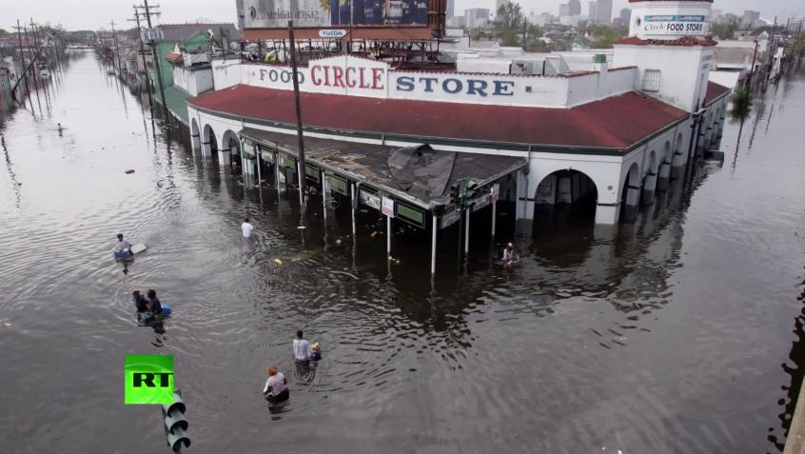
Hurricane Katharina happened in the USA in 2005.

Slide 9
Do the test
True or False
Hurricane Katrina hit New Orleans some years ago.
Brain was visiting his parents.
They heard about hurricane on the radio.
His parents were driving to Texas.
They went to the hotel roof.
They were waiting for three days.
The helicopter took hem to the airport.

Slide 10
Проверь и оцени себя.
1.- T 2- F 3- F 4-T 5 -T 6- F
7-F

Slide 11
Вспомним грамматику.
Give short answers.
Was Brain visiting his parents? _______________
Were they watching TV? ______________
Were his parents visiting relatives? _____________________
Was Brain waiting on the roof for five days? _______________
Were his parents sad?-_________________________________
Выполним по цепочке. Оценим себя.

