Slide 1
My house.
3rd Grade

Slide 2
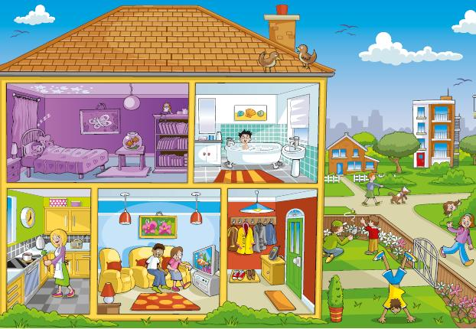
Active vocabulary.
Bathroom – ванная комната
Bedroom – спальня
Dining room – столовая
Garden – сад
Hall – коридор
Kitchen – кухня
Living room – гостиная

Slide 3
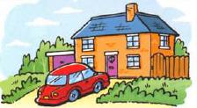
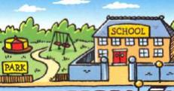
There is\ There are
Singular |  |  |  | Plural
Positive | There | Is ‘s | a big garden. | There | are | two swings
Nagative | There | is not isn’t |  | There | are not aren’t
Questions | Is | There | a big garden? | Are | there | swings?
Short answers | Yes, there is.\ No, there isn’t. |  |  | Yes, there are.\ No, there aren’t.
Wh-questions | How many rooms are there? How many roofs are there? |  |  | There are three. (pl.) There is one. (sg.)
We use “there is” with singular nouns.
There is a big house.
There’s a big house.
We use “there are” with plural nouns.
There are 3 rooms in my flat.
Add “not” to make a negative meaning.
There is not (isn’t ) a TV in this room.

Slide 4
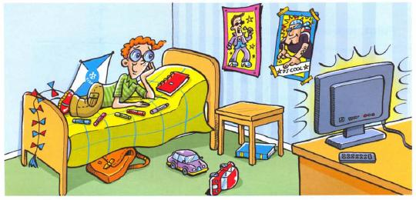
This is my room.
My room.
Correct the mistakes.
There are 3 posters on the walls.
There is a computer on the table.
There are 10 pens on the bed.
There is kite under the bed.
There are 2 windows in the room.
There is a carpet on the floor.
There are 4 books on the table.
There is a purple bag under the bed.

Slide 5
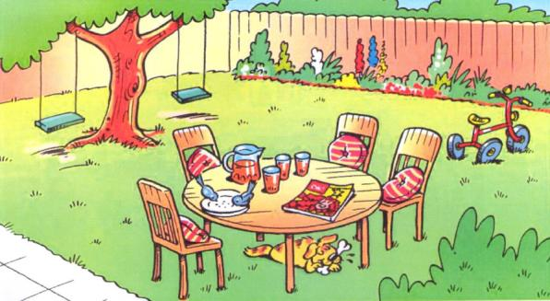
Out side the house…
In the garden.
There ‘s a big table in the garden.
………… four chairs.
………… two swings.
………… a red bike.
………… a dog under the table.
………… three glasses on the table.
………… two birds.
………… a magazine.
………… beautiful flowers and bushes.

Slide 6
Write a letter to your pen-friend.
Moscow, Russia
January, 2016
Dear friend,
My name is Dan. I’m 10 years old. I live in Moscow in a flat. There are 3 rooms in my flat.
My room is the best. There is a bed, a table, a wardrobe, a bookcase and a window in my room. My room is very big and beautiful.
What about you? Where do you live? What do you have in your room?
Write me back.
Dan

Slide 7
Thank you
for your great work!
Good Bye!

