Slide 1
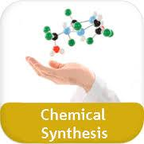
A subject and problems of chemical synthesis. Kinds of chemical synthesis. The basic concepts.

Slide 2
1. A subject of chemical synthesis.
2. Problems of chemical synthesis.
3. Classification synthesizes.
4. The basic concepts and terms of synthetic chemistry.

Slide 3
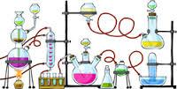
Their one full list would borrow tens volumes. Really, chemicals can be divided into the groups which are switching on related compounds by the nature and materials.. Basically, even in this classification there is no necessity if to consider division of compounds into classes in organic and inorganic chemistry.

Slide 5
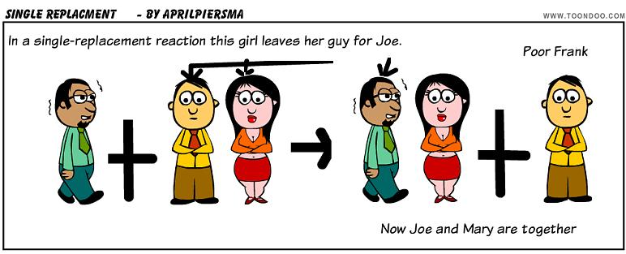
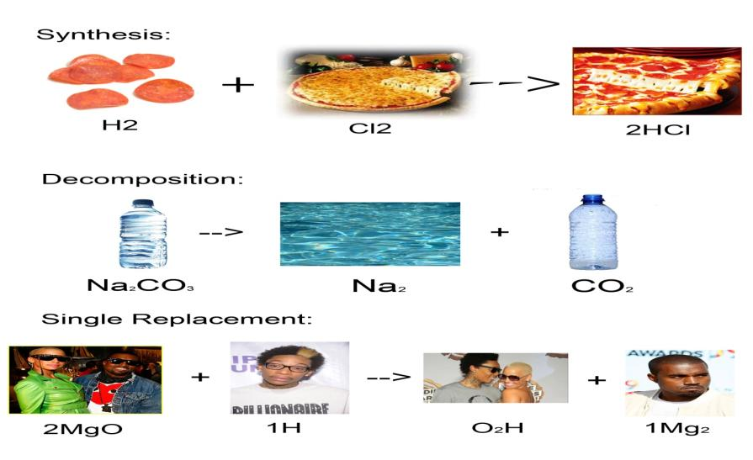

Slide 6
Methods of reception, allocation and identification are developed for each known class of compounds. They can change slightly within the limits of one class of compounds. Thus, as a rule, the method basis – the mechanism of chemical reaction and a way of its realization is conserved

Slide 7
Studying of ways of realization of chemical reactions and allocation of their products are a subject of studying of the synthetic chemistry which bases are stated in a course «Chemical synthesis».

Slide 8
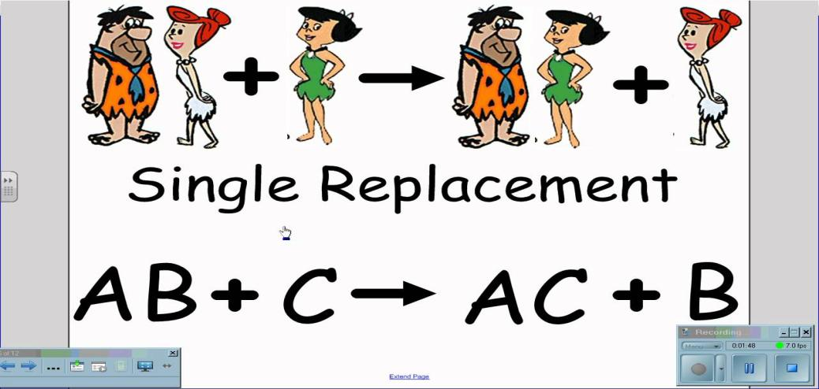
Among problems of chemical synthesis certainly basic is working out of methods of reception of this or that compound and its allocation from a reaction mixture. For the successful decision of this problem often it is necessary to resort to use of representations and the methods developed within the limits of physical chemistry, theoretical inorganic and theoretical organic chemistry.

Slide 9
Thus, the syntheses- chemist should imagine distinctly mechanisms of reactions applied by it, ways of management of them and theoretical bases of used methods of purification of compound. Consideration of these questions is included into course frameworks «Chemical synthesis».

Slide 10
The terms framework of synthetic chemistry has much in common with terminology of other areas of a chemical science. Some concrete definition, possibly, the term "synthesis" demands..

Slide 11
. In practice of synthetic chemistry by synthesis name any reception of a product as a result of chemical reactions. Thus change of complexity of composition and a structure of compounds participating in reaction is not considered

