Slide 1
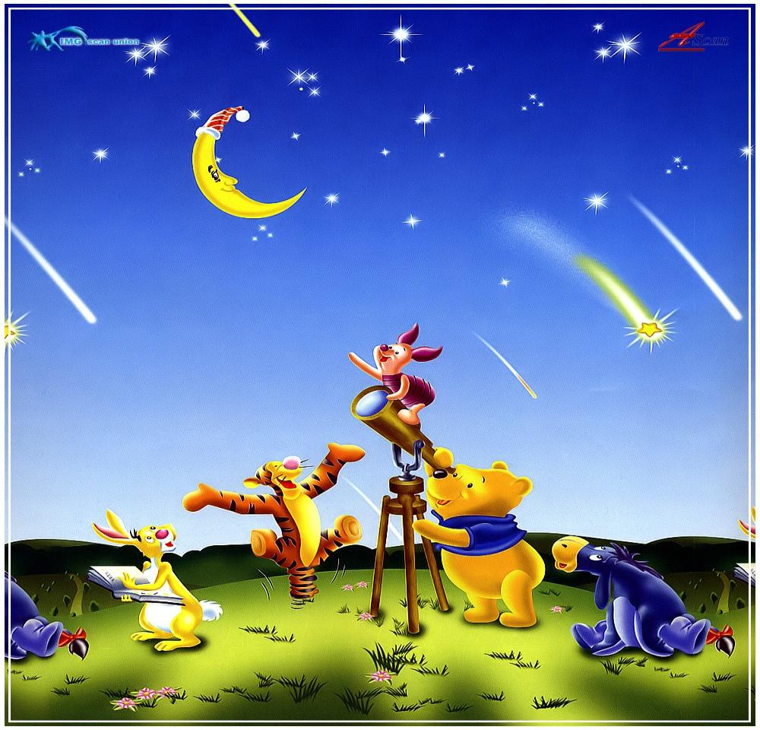
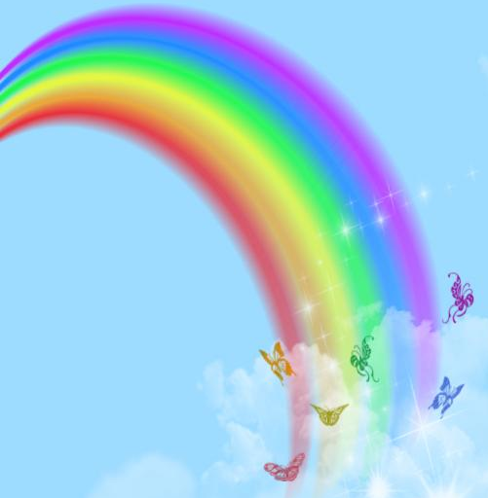
The world of rainbows

Slide 2
Today in our lesson we will:
-checking up homework and talking about environment
-watch video about colour
-new words
-do exercises
-read the dialogue about colour and do the tasks according to the text
-consolidate material

Slide 3
Brown and green, blue and white,
Blue and white, blue and white,
Brown and green and blue and white,
Red and black and yellow.

Slide 4
True or False?
The world is beautiful
Some people destroy forests
People walk in the mountains.
They destroy the grass.
In Kazakhstan on the Zhaiyk River the factories pollute the river with dirty water.
We help the environment a lot.
True

Slide 5
video

Slide 6
The 16th of February.
Thursday
What colour is your cat?

Slide 7
green
yellow
blue
orange
white
grey
red
brown
black

Slide 8
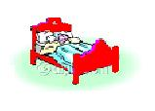
Red
What can be red ?
a flag
an apple
a bed
a pen
a rose

Slide 9
Orange
Orange is the tiger
Jumping on the floor

Slide 10
Yellow
Yellow are flowers
Growing near my door

Slide 11
Blue
Blue is the sea

Slide 12
Green
Green is the grass

Slide 13
White
White are the clouds
As they slowly pass

Slide 14
Grey
My cat is grey
It likes to play

Slide 15
Black
My dog is black
His name is Jack

Slide 16
Brown
Brown Winnie is funny
He likes to eat honey

Slide 17
Exercise 2 on page 164
Reading.

Slide 18
Red and yellow,
White and blue
All the colours
Are just for you!

Slide 19
What is the missing?

Slide 20
What colour is missing?

Slide 21
What colour is missing?

Slide 22
What is missing?

Slide 23
Write the missing letters
Y_llo_
Gr_ _n
Pu_pl_
O_an_e
P_n_

Slide 24
Write the missing letters
_lu_
R_d
B_o_n
Gr_y
Bl_c_

Slide 25
Colour sums
yellow
+
blue
=
red
+
yellow
=
?
black
+
white
=
?
red
+
yellow
+
blue
=
?

Slide 26
Colour sums
yellow
+
blue
=
green
red
+
yellow
=
orange
black
+
white
=
grey
red
+
yellow
+
blue
=
brown

Slide 27
video

Slide 28
Do you know flags and colours?

Slide 29
Homework
Exercise 9 on page 165

Slide 30
Good luck !

