Slide 1
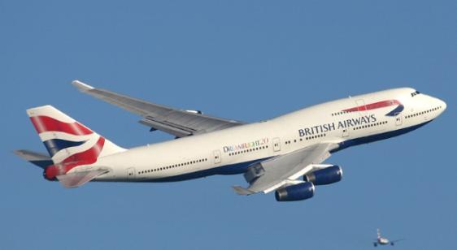
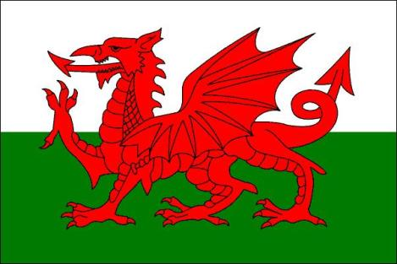
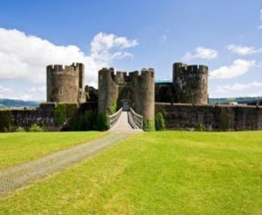
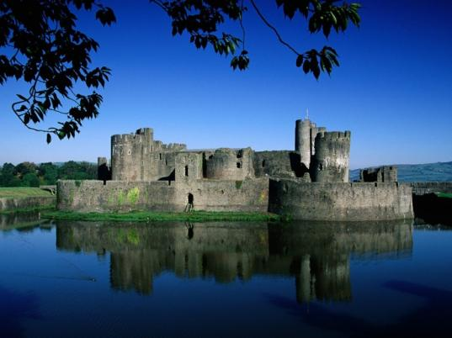
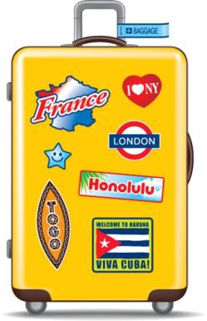
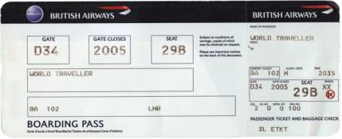
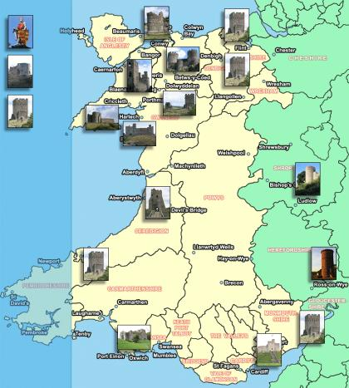
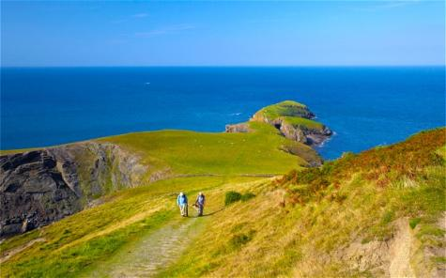
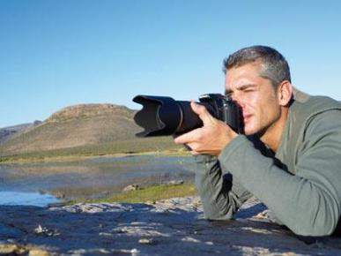

Slide 2
Listening
What countries are Welsh spoken?
When was Welsh banned?
How many people speak Welsh now?
How wide is Welsh used in Wales nowadays?

Slide 3
Travelling to Wales

Slide 4
Speaking

Slide 5
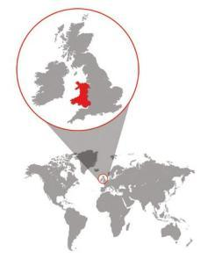
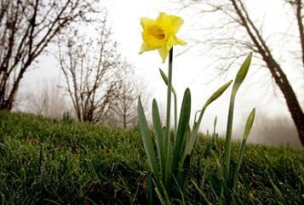
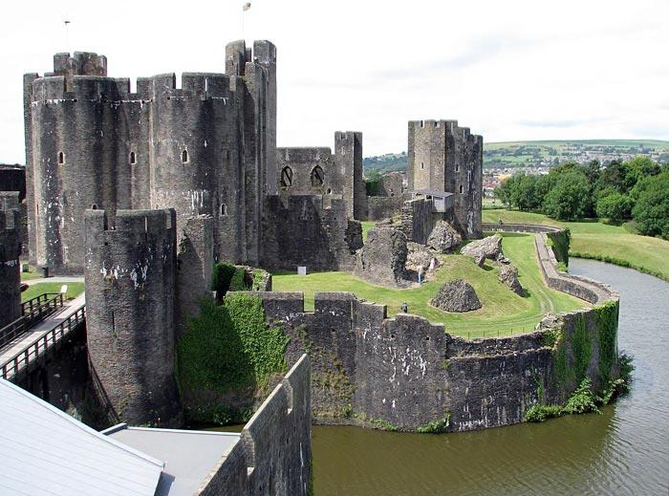
Wales is a beautiful country,
Wales is a wonderful land.
Visit the daffodil valleys,
Come and enjoy them!

Slide 6
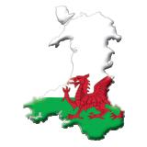
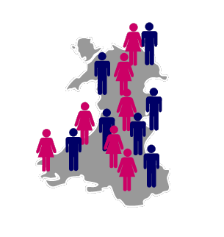
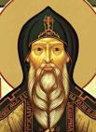
Facts about Wales
Anthem: Hen Wlad Fy Nhadau (Land of my Fathers )
Motto: Cymru am byth (Wales forever)
Capital: Cardiff
Other major towns: Swansea, Newport, Wrexham
Official Languages: Welsh, English
Government: Welsh Government
Area: 20,780km²
Population: 3,006,430
Population density: 145 persons per square kilometer
Patron Saint: St David
Currency: Pound Sterling (£)

Slide 7
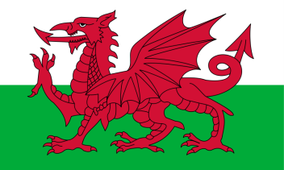
Flag
The national flag of Wales is the Red Dragon. No one knows for sure how the red dragon came to become a symbol of Wales. Its origin is now lost in history and myths. It was officially recognised as the Welsh national flag in 1959.

Slide 8
The National Symbol of Wales
Wales has got two national symbols.
These are the daffodil and the leek.
They are both connected to the Patron Saint of Wales.
Today each year on St. David's Day the leek is worn in the cap badges of every soldier in every Welsh regiment.
But outside the army, many other Welsh people have substituted the leek by the daffodil, perhaps because it looks more attractive and certainly smells a lot better.
The daffodil is also associated with St. David's Day, due to the fact that it breaks into blossom on that day. Interesting to note that one of the many Welsh names for a daffodil is "Cenhinen Bedr" which means "Peter's leek".

Slide 9
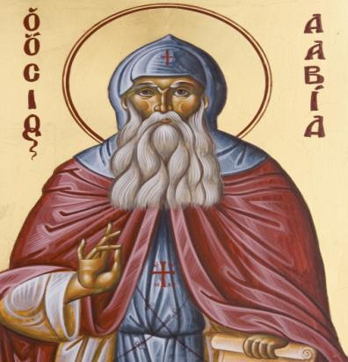
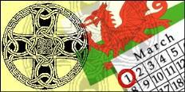
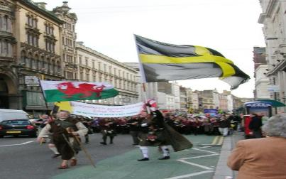
St. David is the patron saint of Wales.
He was a monk who lived on bread, water, herbs and leeks and died on March 1, 589 A. D.
March 1st,St.David’s Day is
now Wales’s national day.

Slide 10
Cardiff is the capital and largest city of Wales. The Welsh name of the city is Caerdydd. It is situated near the mouth of the Taff River. It has a population of approximately 320,000. It is an important industrial city and a port.

Slide 11
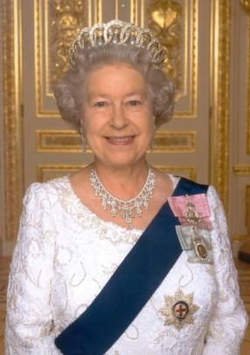
Government
Wales is a country that is a part of the United Kingdom (UK).
Constitutionally, the UK is a parliamentary monarchy. In the House of Commons - the lower house of the UK government - Wales is represented by 40 Member of Parliament (of 646) from Welsh constituencies.
The head of the UK is the British monarch, Queen Elizabeth II.

Slide 12
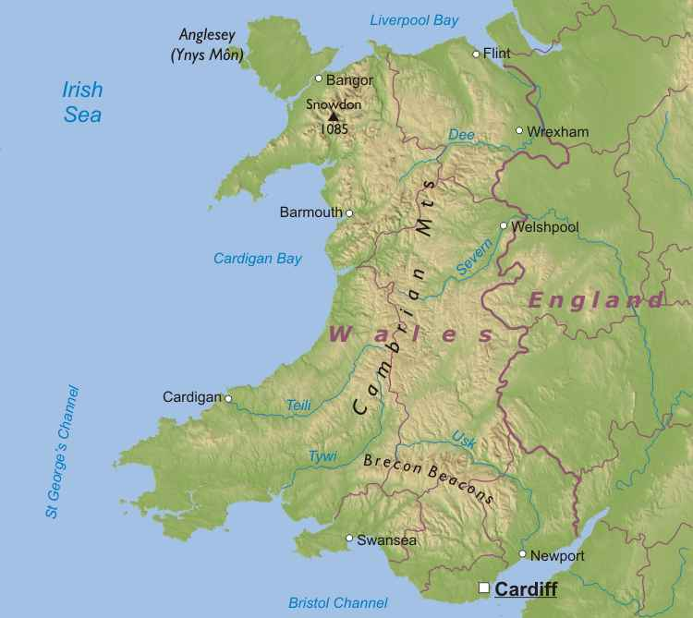
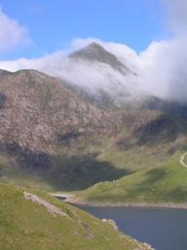
Geography
Wales is a part of the United Kingdom and is located in a wide peninsula in the western portion of the island of Great Britain.
Wales is bordered by England to the east and by sea in all other directions: the Irish Sea to the north and west, St George's Channel and the Celtic Sea to the southwest and the Bristol Channel to the south.

Slide 13
It has a changeable, maritime climate and is one of the wettest countries in Europe. Welsh weather is often cloudy, wet and windy, with warm summers and mild winters.

Slide 14
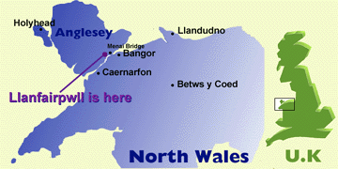
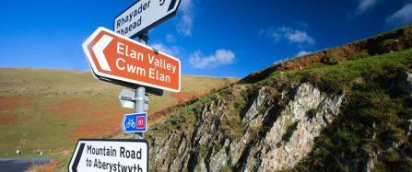
Wales has two official languages: English and Welsh
For about 20% of the population, the mother tongue is Welsh.
Interesting to know:
Road signs in Wales are generally in both English and Welsh.
Llanfairpwllgwyngyllgogerychwyrndrobwllllantysiliogogogosh.
This is the longest place-name in the UK and, probably, in the whole world.

Slide 15
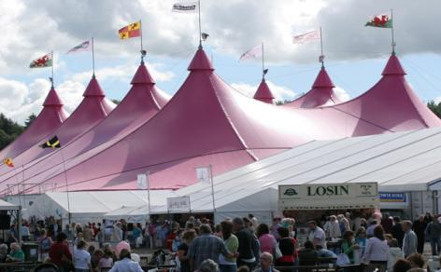
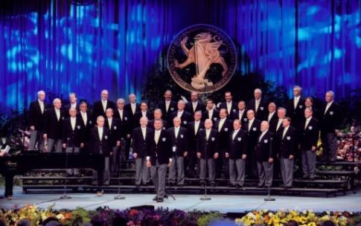
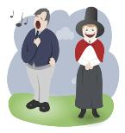
The Welsh people are fond of folk music, singing, poetry and drama.
Every year an international festival called Eisteddfod is held in Wales. It is a festival of Welsh culture. People come from all over the world to recite poetry, sing and dance in this colourful competition.

Slide 16
Bibliography
www.wales.com
www.en.wikipedia.org/wiki/Wales
www.lonelyplanet.com/wales/
www.britannia.com/celtic/wales/
www.cymraeg.ru/gwybodaeth.html
www.krugosvet.ru/enc/Earth_sciences/geografiya/UELS.html

