Slide 1
English is the language of the world

Slide 2
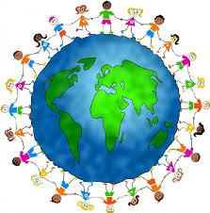
What unites people in the world?

Slide 3
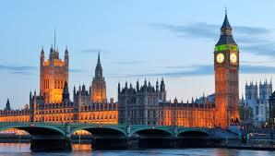

Slide 4
if I know enough about britain
if I’d like to know more

Slide 5
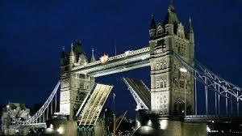
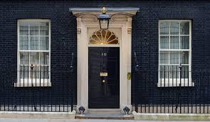
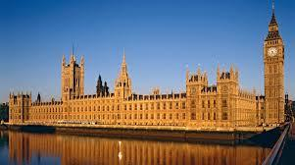
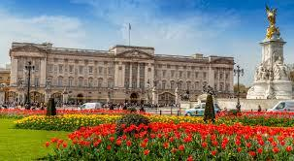
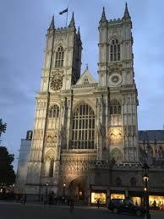
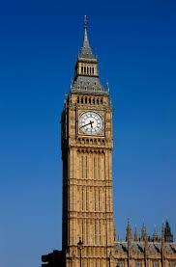
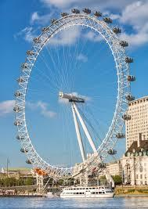
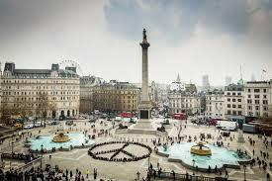

Slide 6
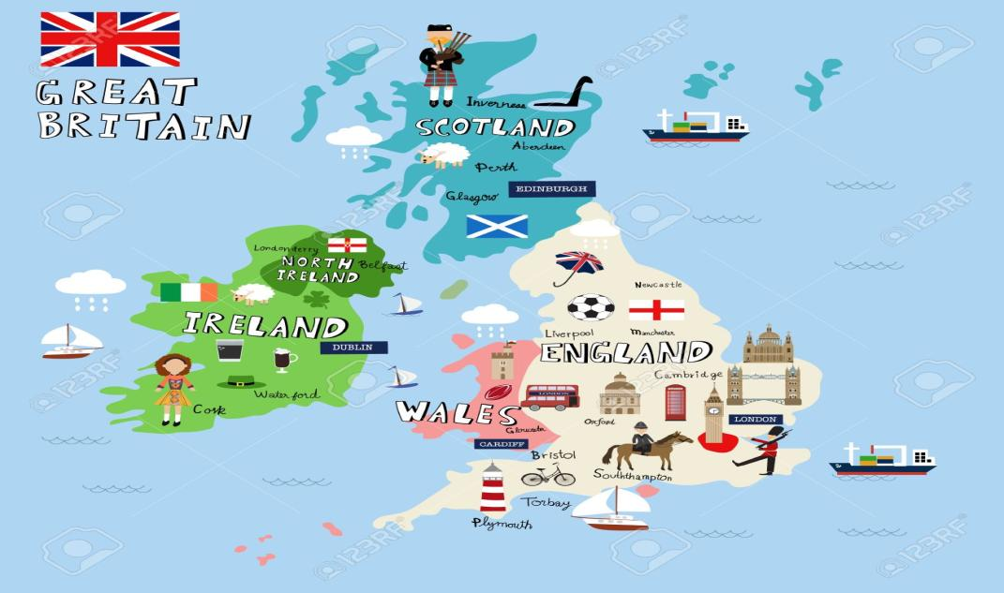

Slide 8
The symbols of the UK
 | ENGLAND | WALES | SCOTLAND | NORTHERN IRELAND
CAPITAL
EMBLEM
PATRON SAINT
FLAG

Slide 9
The symbols of the UK
 | ENGLAND | WALES | SCOTLAND | NORTHERN IRELAND
CAPITAL | LONDON | CARDIFF | EDINBURGH | BELFAST
EMBLEM
PATRON SAINT | SAINT GEORGE | SAINT DAVID | SAINT ANDREW | SAINT PATRICK
FLAG

