Slide 1
Adjectives with cats

Slide 2
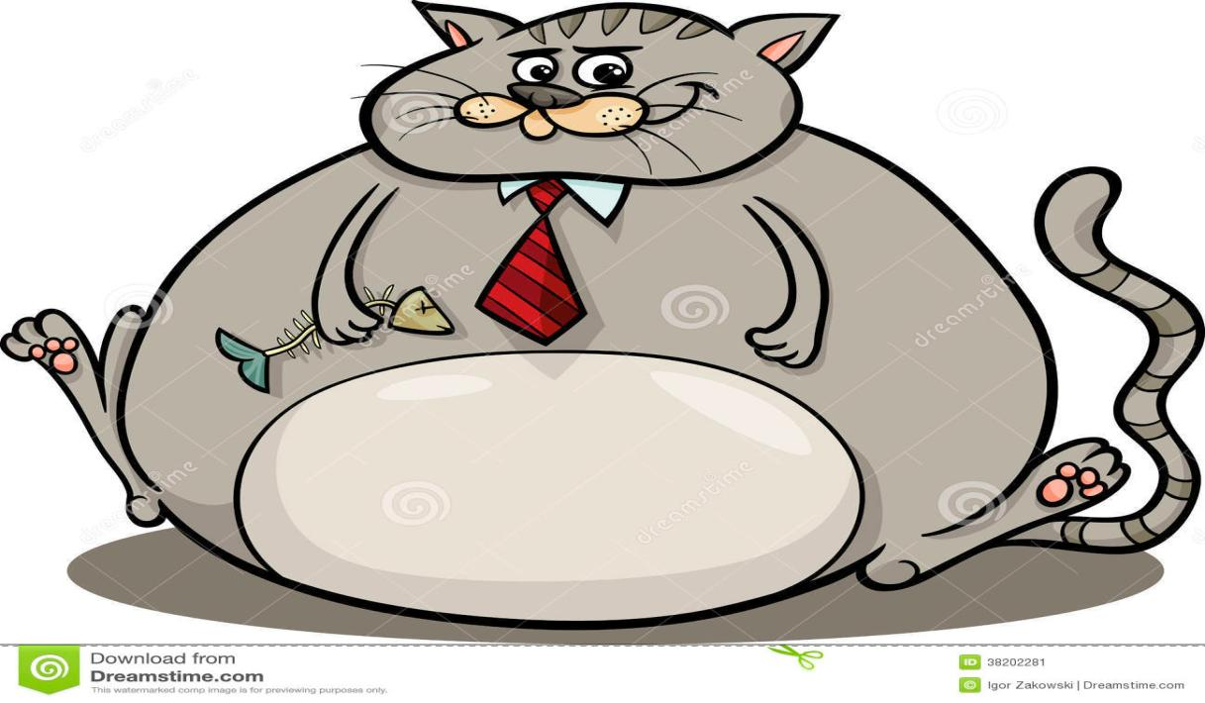
Fat

Slide 3
Thin

Slide 4
Sad

Slide 5
Happy

Slide 6
Fast

Slide 7
Slow

Slide 8
Old

Slide 9
Young

Slide 10
Tall

Slide 11
Short

Slide 12
Bad

Slide 13
Good

Slide 14
Clean

Slide 15
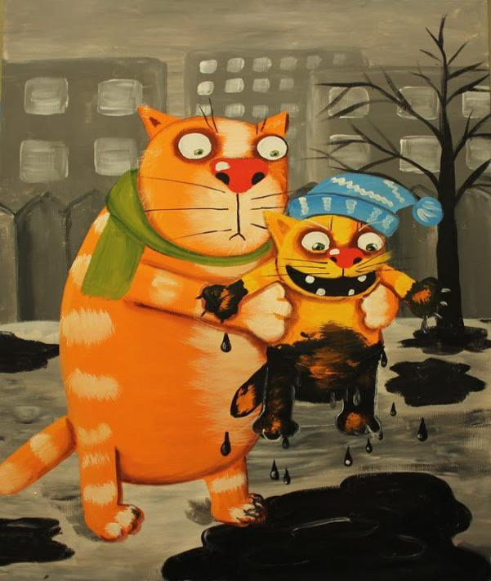
Dirty

