Slide 1
India
Выполнили: Исаева Татьяна
Фёдорова Маргарита

Slide 2
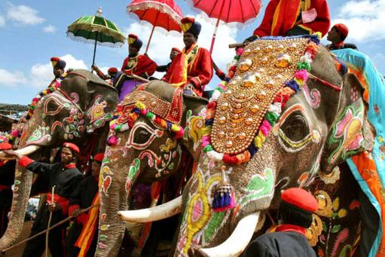
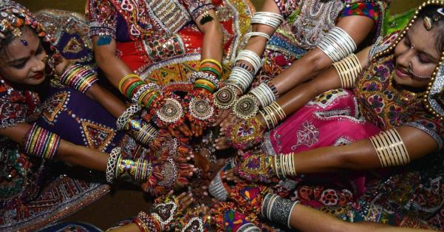
India - the country of rich culture and history. During the travel across India it is possible to be transferred to absolutely other world of the East.

Slide 3
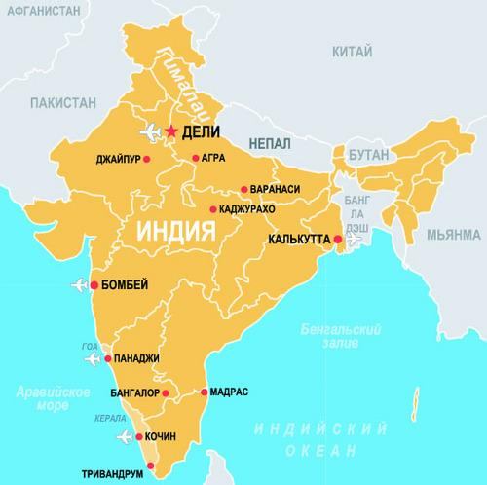
India is located in the south of Asia on the peninsula of Hindustan between upper courses of the rivers of system of Indus in Punjab in the West and river system of Ganges in the east. In the north the country borders on China, Bhutan and Nepal, in the northwest - on Pakistan, in the east - on Myanmar and the People's Republic of Bangladesh.

Slide 4
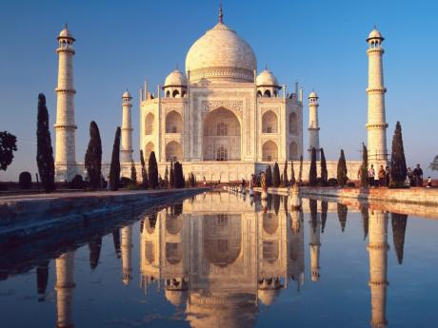
India — the federal republic. The head of state — the president. It is elected the board of voters consisting of both chambers of parliament and legislature of states for 5-year term. Legislature — two-chamber parliament. Consists of Council of states and People's Assembly. Executive power is carried out by the government headed by the prime minister appointed by the president.

Slide 5
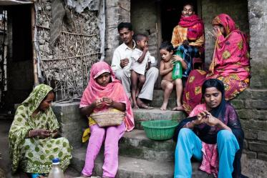
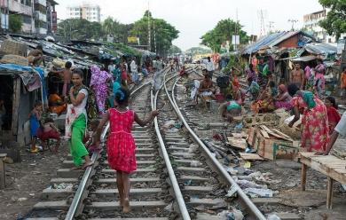
India - the bright and diverse country, whose economy is more and more integrated with world economy. The developed economic reforms undertaken last decade had far-reaching consequences. The huge and constantly growing market, the developing infrastructure, difficult financial sector, the flexible regulating environment, privileges, the steady state and good economic prospect does India attractive to investments. The business environment of India favors to achievement of high level and constant growth. But still a quarter of the population lives below the poverty line.

Slide 6
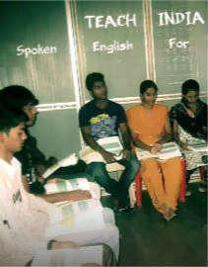
State languages of India Hindi and English. Lately in India English is often used. Hindi films are now written in English — the instructions in the screenplays are in English, and even the Hindi dialogue is transcribed in the Latin alphabet. Many Indians would say that India’s national language is Hindi. They would say it with pride if they are from the north and with a good-natured grouse if they are from the south. But this is a misconception. The fact is that, according to the Indian Constitution, the country does not have a national language.

Slide 7
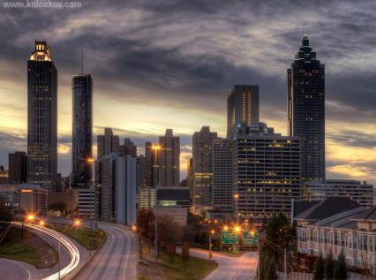
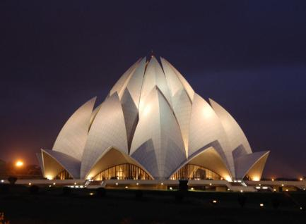
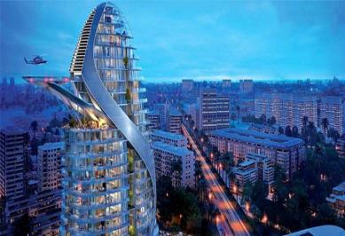
New Delhi, the capital of India is, the constructed by British in the 19th century, spacious green area which is in the territory of the megalopolis of Delhi. New Delhi differs from Old Delhi in smart hotels, huge shops. Radzhpakh Avenue, "Gate of India", the Presidential Palace and the building of Parliament – all this New Delhi. The old city is constructions which were built throughout many millennia. In the Indian history Delhi it is mentioned as "the Capital of Seven Empires"

Slide 8
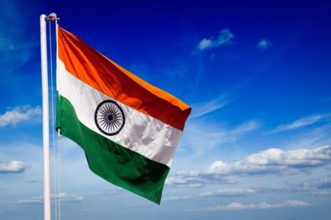
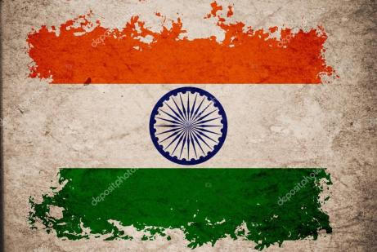
Flag of India - one of the state symbols of Republic of India. National flag of India represents a rectangular panel from three horizontal strips of equal width: top — "deep shafranny", average — white and lower — green color. In the center of a flag the image of a wheel with 24 spokes, dark blue color is located. Orange color of a flag indicates spirituality, white — peacefulness, green — fertility, and a circle — a religious symbol.

Slide 9
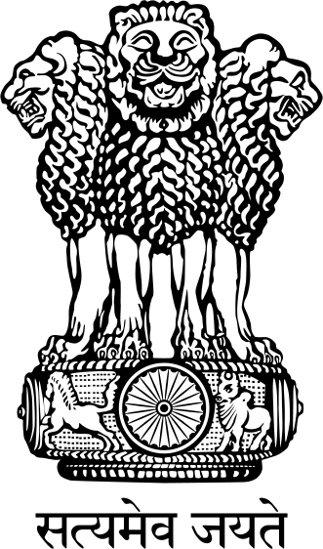
On the coat of arms four Indian lions on a round abacus are represented. The fourth lion is behind and, therefore, is hidden from a look. The coat of arms symbolizes the nation which "is brave in bravery, is strong in a body, is reasonable in council and frightens opponents". The abacus is decorated by four animals — symbols of four directions: A lion — the North, the Elephant — the East, the Horse — the South and the Bull — the West (on the image only the Horse and the Bull are visible). The abacus leans on the lotus on top form symbolizing a life source.

Slide 10
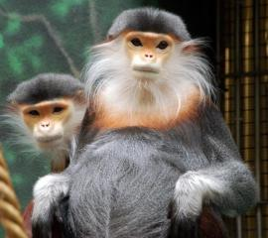
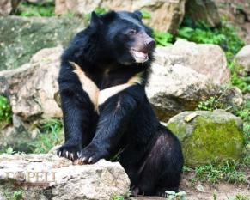
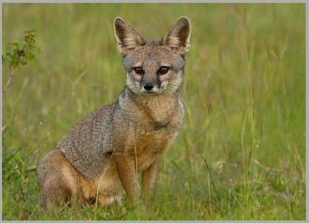
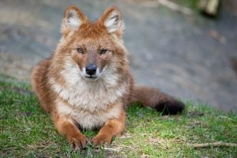
In India there live such large animals as the Indian lion, the Indian elephant, the Indian rhinoceros and the Bengalese tiger. Predators — a leopard, a belogrudy bear (or the Himalaya bear), cheetahs, the Indian wolf, the Bengalese fox, an ordinary jackal, a striped hyena and a red wolf. In India macaques, tonkotely monkeys and mongoose which often live in the inhabited places, sometimes in urban areas are also well-known.

Slide 11
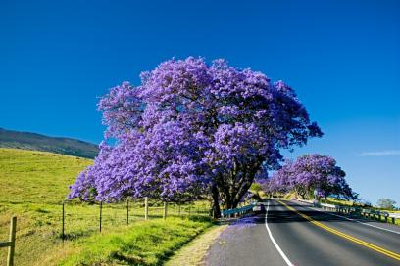
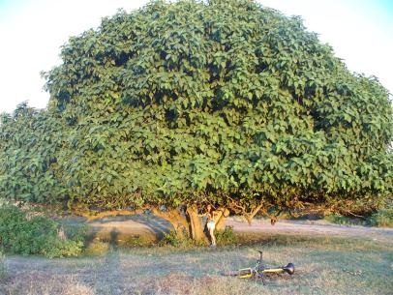
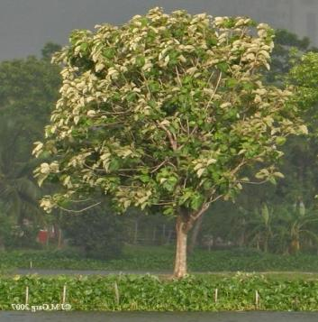
On wealth and a variety of vegetation India is high on the list among the countries of the world. Here grow: Himalaya cedar, fir, fir-tree, pine, palisander, tic, chestnuts, cinnamon tree, plums, birches, fig tree etc.

Slide 12
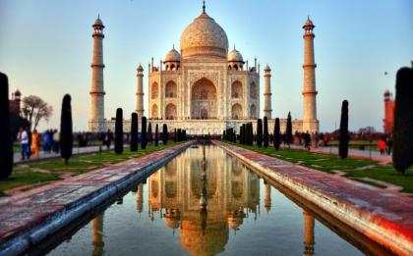
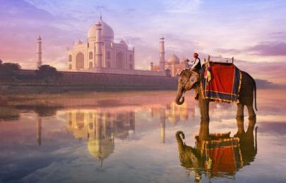
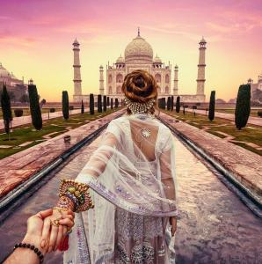
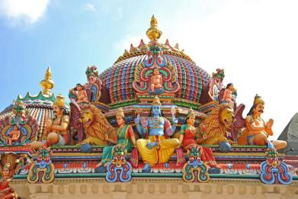
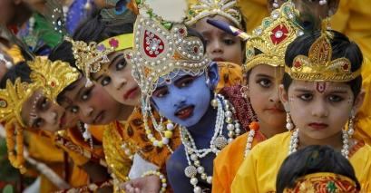
India, simple and great, will leave nobody indifferent.

