Slide 1
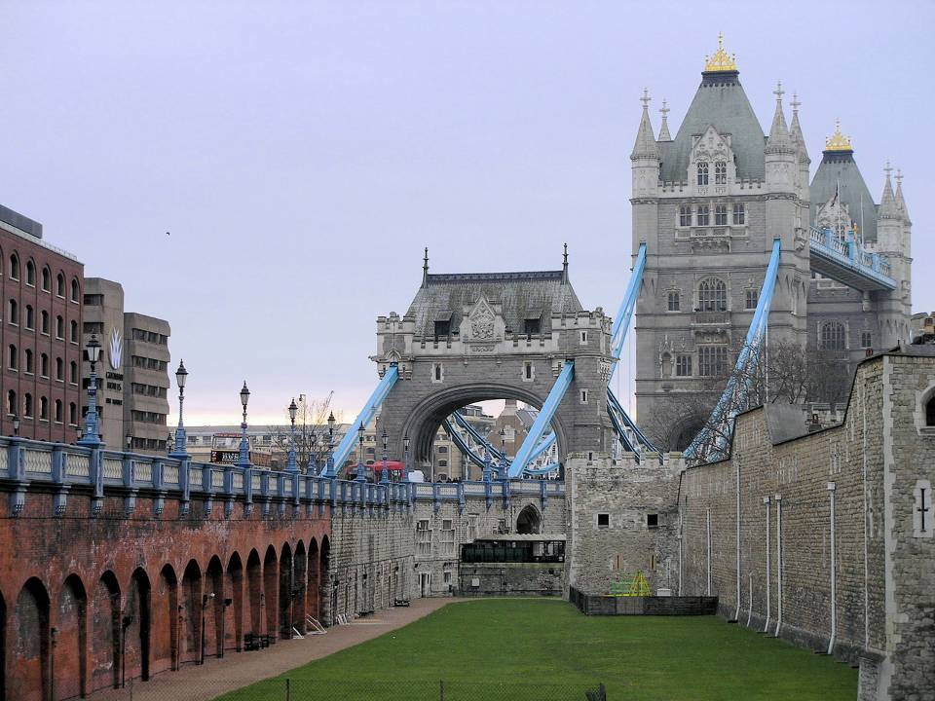
The United Kingdom of Great Britain and Northern Ireland
Учитель английского языка
МБОУ Гимназия №36 г. Иваново
Данилочкина Е.С.

Slide 2
The British Isles
The UK is situated in the British Isles. The big island is called Great Britain
The small one is called Ireland
Great Britain is washed by the North Sea, the Irish Sea and the English Channel

Slide 3
The UK consists of
The UK
England
Scotland
Wales
Northern Ireland

Slide 4
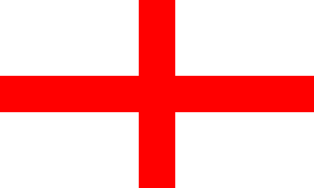
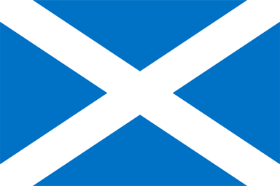
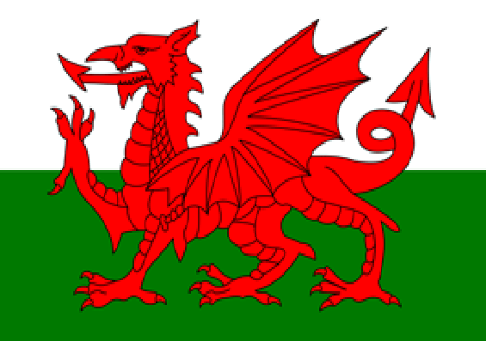
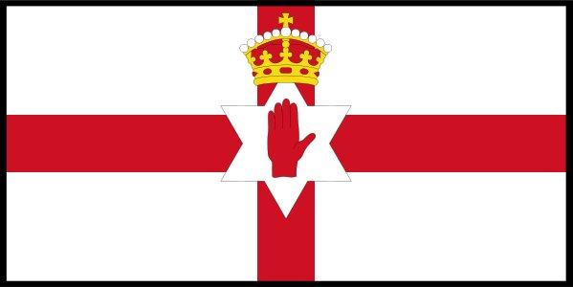
Union Jack- the flag that consists of the flags of England, Scotland and Northern Ireland

Slide 5
Union Jack
In 1606 Scotland joined England and Wales. The Scottish flag- St. Andrew's Cross –was added to the English Flag- St. George's Cross. Later, in 1801 when Ireland was joined to the union, the Irish Flag - St. Patrick's Cross -was added. The Union Jack is also on the flags of Australia and New Zealand.

Slide 6
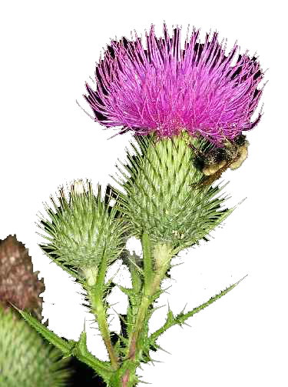
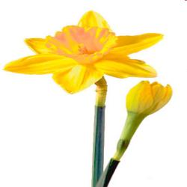
The national symbols
England Rose
Scotland
Thistle
Wales
Daffodil
Northern Ireland
Shamrock

Slide 7
The head of the UK is Queen Elizabeth II

Slide 8
England

Slide 9
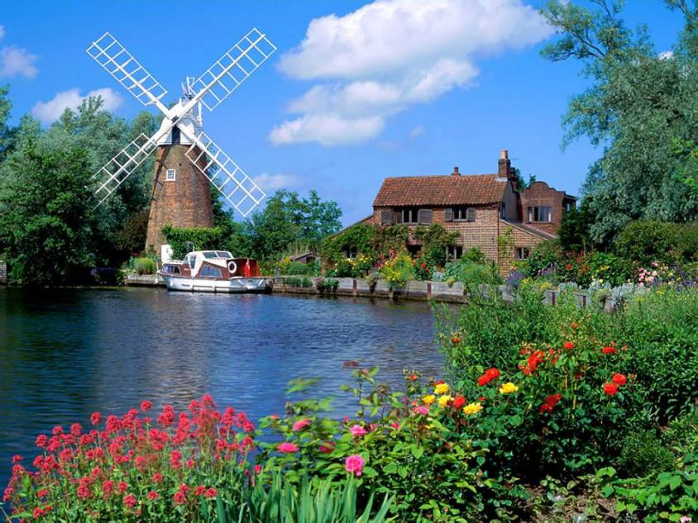
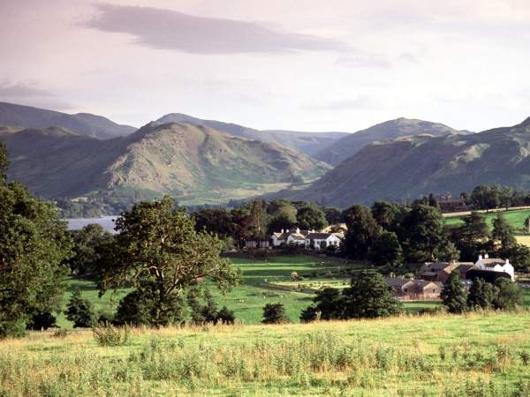
Rivers and mountains
There are no long rivers in Great Britain. The longest one is the Severn
There are no high mountains there. The highest one is Ben Nevis

Slide 10
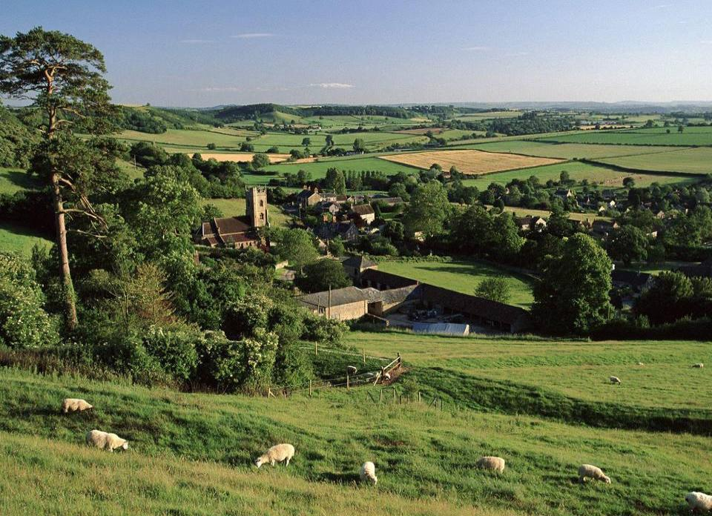
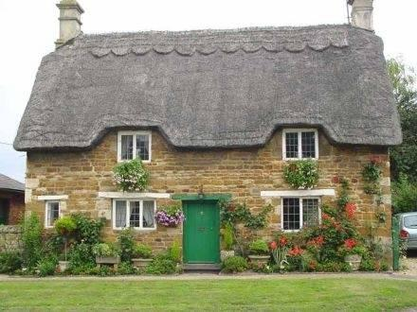
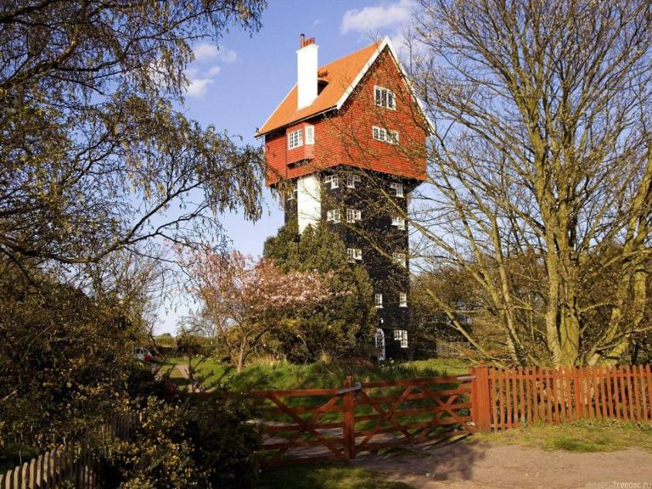
English countryside and climate
English landscape is picturesque. There are a lot of meadows and valleys
The weather in Great Britain is changeable. The British like talking about it.
It’s not very cold in winter and not very hot in summer. It’s often rainy and foggy there.

Slide 11
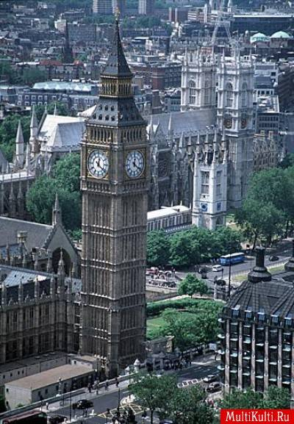
London, the capital of the UK, has a lot of tourist attractions
The British are proud of the Houses of Parliament, Big Ben, the Tower of London, Trafalgar Square, Westminster Abbey, London parks, and many other sights. Don’t miss a chance to see them!

Slide 12
It’s one of the symbols of London- Big Ben

Slide 13
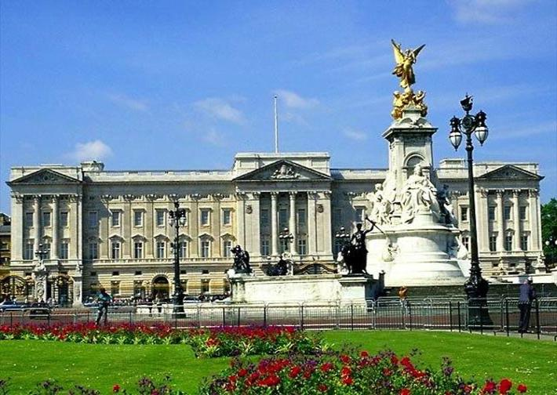
Buckingham Palace
It is the home of the Queen when she is in London. It has 600 rooms,78 bathrooms,a cinema, a swimming pool and a post-office. There is a nice park near it. 450 people work in the palace

Slide 14
Westminster Abbey
It’s the Royal church.
It’s the place of coronation of all the British kings and queens. Elizabeth II was coronated there in 1953
A lot of famous writers, poets, painters, scientists are buried there.

Slide 15
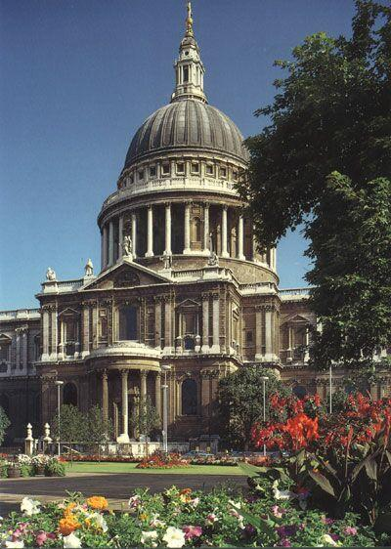
St. Paul’s Cathedral
St. Paul’s Cathedral was designed by Sir Christopher Wren
It took him 35 years to build the Cathedral.
It’s one of the most famous places of interest in London.

Slide 16
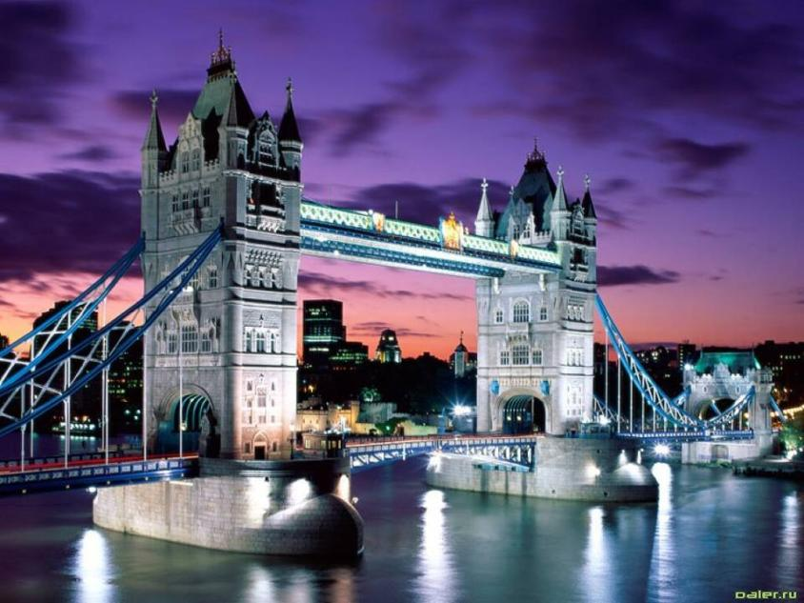
The Tower of London and Tower Bridge
The Tower was a prison, a mint, a palace and a zoo. Now it’s a museum and a lot of tourists visit it every year

Slide 17
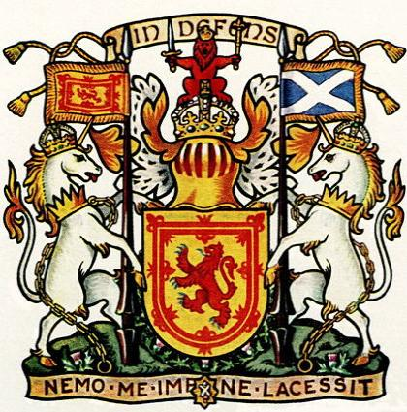
Scotland

Slide 18
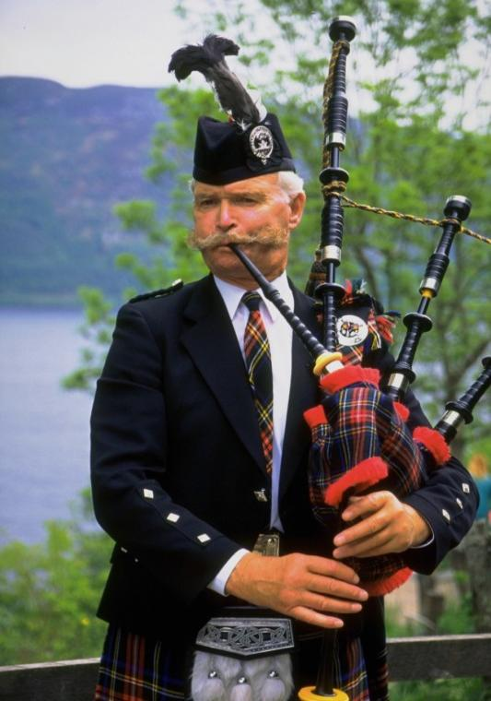

Slide 19
The capital of Scotland is Edinburgh

Slide 20
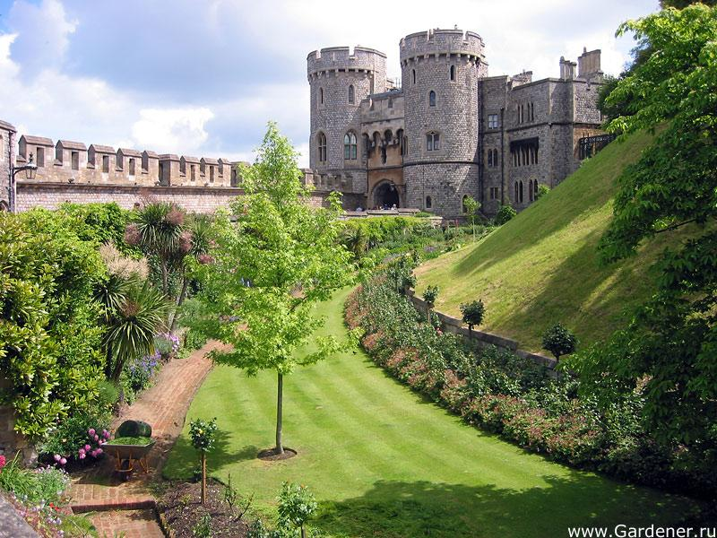
Scotland is the land of old castles

Slide 21
Wales

Slide 22
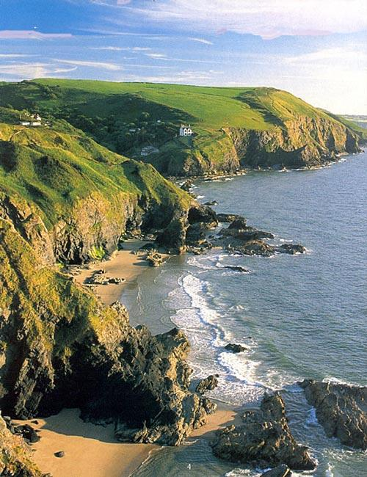
Wales

Slide 23
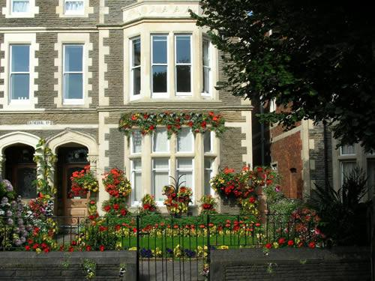
The capital of Wales is Cardiff

Slide 24
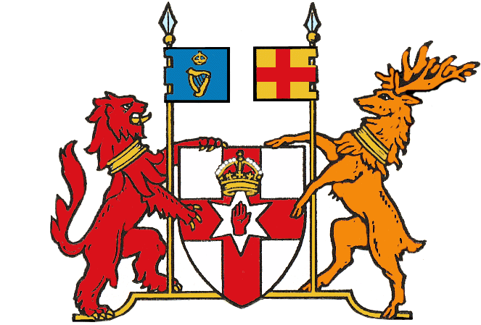
Northern Ireland

Slide 25
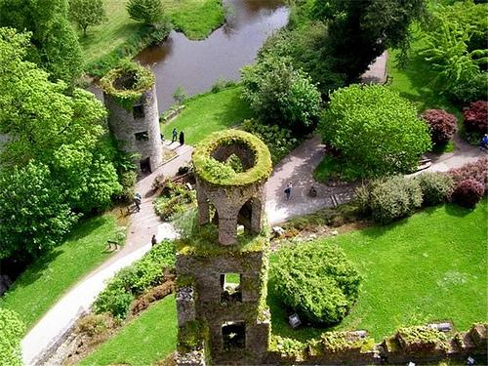
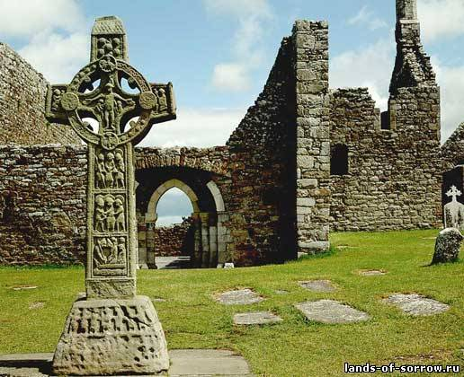
Northern Ireland

Slide 26
The capital of Northern Ireland is Belfast

Slide 27
Question time
1
4
5
6
7
2
3
8
9
10

Slide 28
Question time
1.What is the full name of the country?
2.Where is it situated?
3.What oceans is it washed by?
4.What countries does the UK consist of?
5.What is the national emblem of England?
6.What can you say about the flag of the UK?
7.What about the rivers and mountains?
8.What about climate?
9.What’s the capital?
10.What is London famous for?

Slide 29
Thank you!

