Slide 1
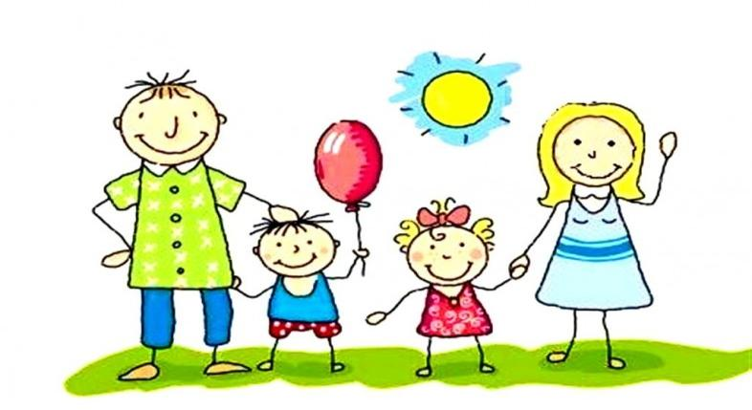
One big happy family

Slide 2
How are you today?
How old are you?
Who is absent today?
We are beginning our lesson!

Slide 3
All |ɔːl|
All
Tall
Small
Fall
Call
Ball
Hall
Mall
Wall

Slide 4
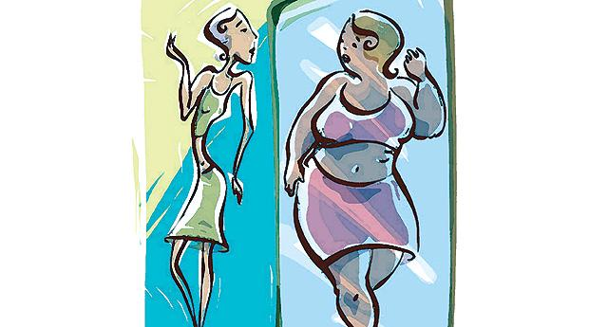
Slim plump

Slide 5
Short tall

Slide 6
Dark hair

Slide 7
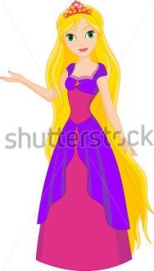
Fair hair

Slide 8
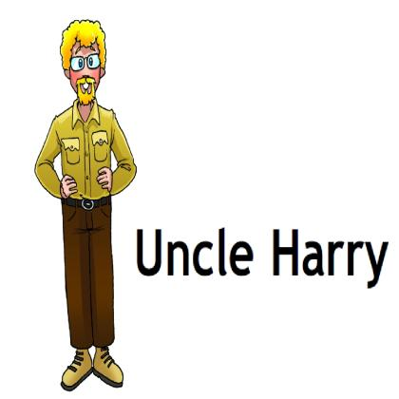
What does Uncle Harry look like?
What’s he like?
He’s tall and slim and he’s got fair hair
He’s very funny!

Slide 9
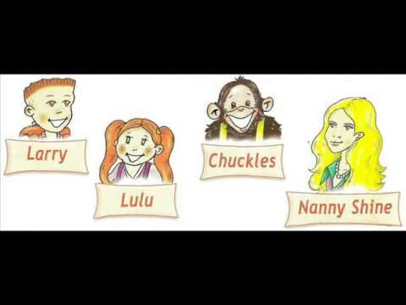
Act out the dialogue
For example:
What does Nanny Shine look like?
She’s tall and slim and she’s got fair hair.
What’ she like?
She’s very kind.

Slide 10
Let’s have a rest

Slide 11
Answer the questions
What does your mum look like?
What is your grandpa like?
What does your best friend look like?
What is your best friend like?

Slide 12
Homework
Workbook: p. 6 ex.2

