Slide 1
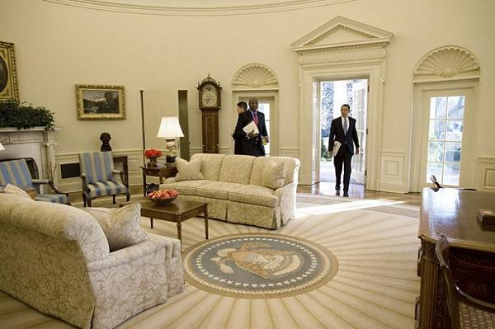
The Oval Office
the official office of the President of the United States

Slide 2
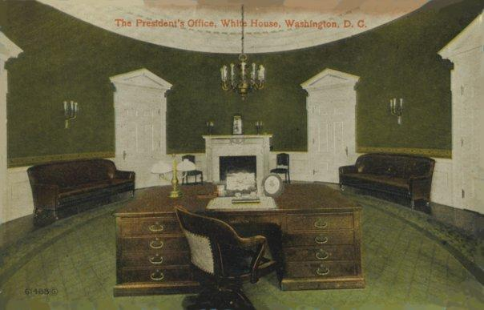
Main
Created in 1909 as part of an overall expansion of the West Wing of the White House during the administration of William Howard Taft
the 1st Oval Office, designed by Nathan C.Wyeth for President William Howard Taft

Slide 3
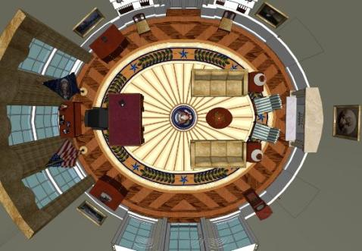
Architecture and furnishings
was inspired by the elliptical Blue Room
three large south-facing windows behind the president's desk and a fireplace at the north end of the room
The Oval Office has four doors
An oval interior space is a Baroque concept that was adapted by Neoclassicism

Slide 4
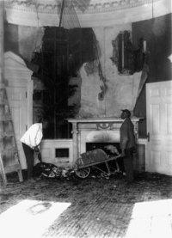
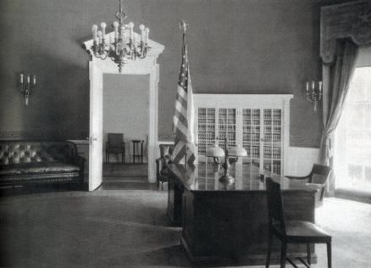
Architecture and furnishings
December 24, 1929 - a fire damaged the West Wing. President Franklin D. Roosevelt engaged a staff architect, Eric Gugler, to redesign the West Wing with the Oval Office placed in the southeast corner more robust Georgian details

Slide 5
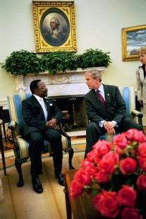
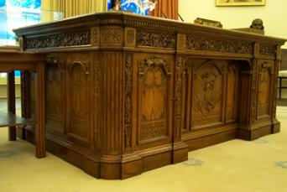
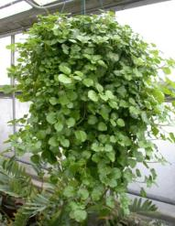
Architecture and furnishings
Traditional decorations:
the Resolute desk, so named because it was built from the timbers of the British frigate HMS Resolute
a portrait of George Washington over the mantel on the north end of the room
a tradition of displaying potted Swedish ivy (Plectranthus verticillatus) atop the mantel

Slide 6
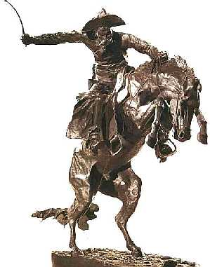
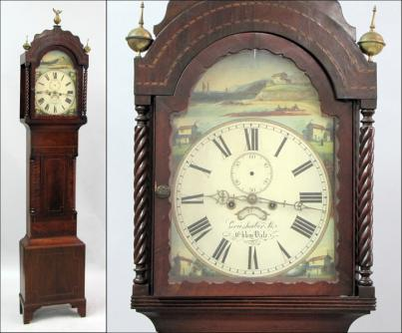
Architecture and furnishings
A series of bronze sculptures of horses and Western themes by Frederic Remington
A large case clock, commonly called a grandfather clock, built in Boston by John and Thomas Seymour, c. 1795-1805

Slide 7
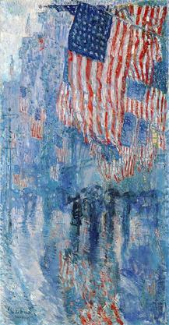
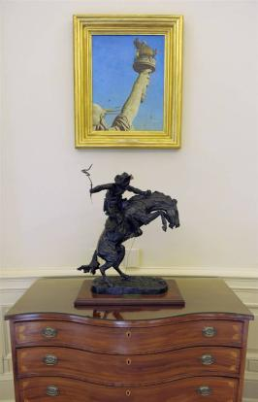
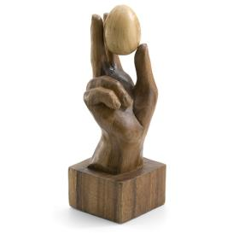
Architecture and furnishings
Since President Barack Obama took office in 2009 he made some changes
and subtle additions in the decorations
Norman Rockwell, The Statue of Liberty
a hand-carved wooden sculpture from Kenya, symbolizing the fragility of power
Childe Hassam ,The Avenue in the Rain and Norman

Slide 8
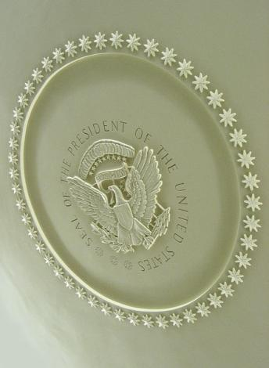
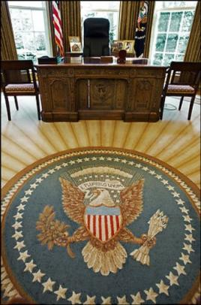
Architecture and furnishings
Oval Office carpet
The carpet of the oval
office bears the Seal of
the President
Plaster celling medallion (since 1934)

Slide 9
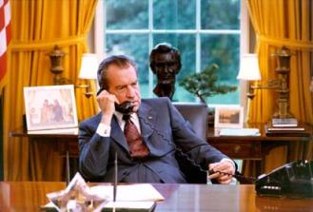
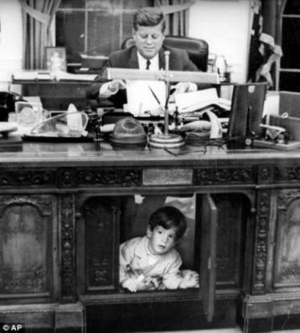
History
The Oval Office is associated in Americans' minds with the presidency itself through memorable images, such as a young John F. Kennedy, Jr. peering through the front panel of his father's desk, Richard Nixon speaking by telephone with the Apollo 11 astronauts after their successful voyage, and Amy Carter bringing her Siamese cat Misty Malarky Ying Yang to brighten President Jimmy Carter's day

Slide 10
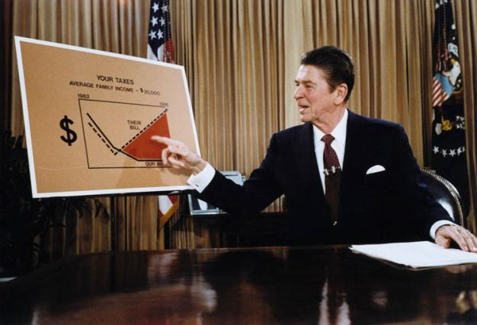
History
Use of the Oval Office for television broadcasts is rare and reserved for occasions with a sense of gravity
Ronald Reagan gives a televised adress from
the Oval Office

