Slide 1
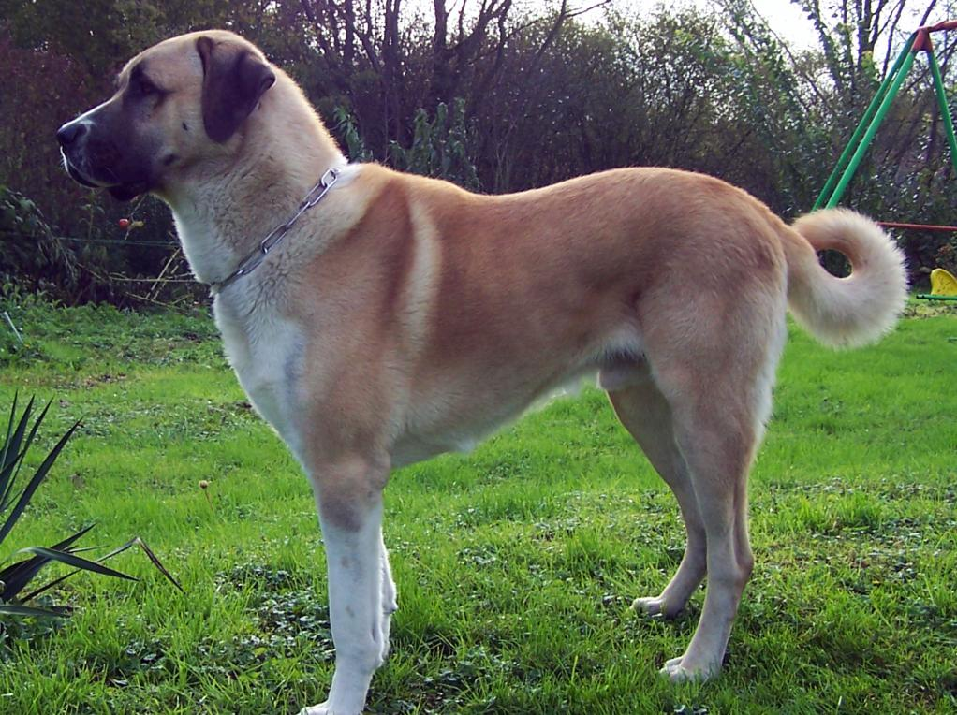
A Dog
Mini-Encyclopedia
by
Olga Stepanova, Chadukassinskaya Main School, Chuvashia

Slide 2
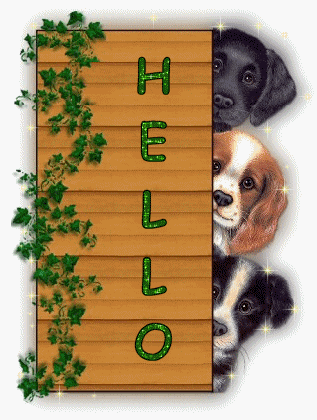
Gently
Assisted by
three Friends

Slide 3
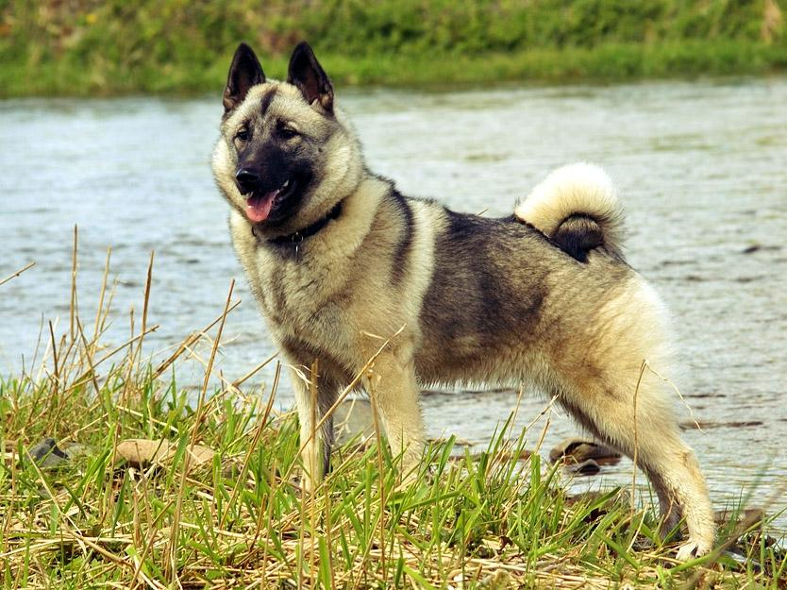
Contents
The Meaning of the Word
The Morphology of a Dog
The Proverbs and Sayings about dogs
Dogs & Superstitions
Poems
Some interesting facts
The Most Touching Film
A Video from gif.com
ДАЛЕЕ

Slide 4
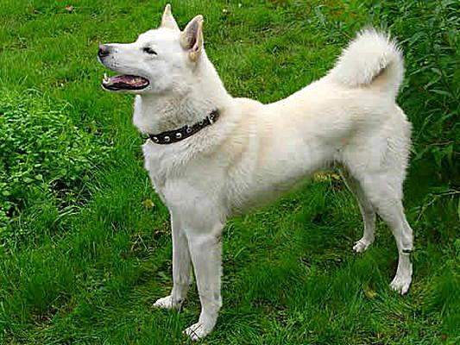
The Dog
The Definition from Wikipedia
The dog is a subspecies of the gray wolf a member of the Canidae family of the mammalian order Carnivora. The term "domestic dog" is generally used for both domesticated and feral varieties. The dog was the first domesticated animal and has been the most widely kept working, hunting, and pet animal in human history.The word "dog" can also refer to the male of a canine species, as opposed to the word "bitch" which refers to the female of the species.
НАЗАД
The Definition from Wikipedia

Slide 5
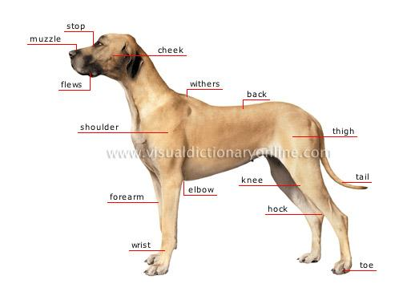
The Morphology of a Dog

Slide 6
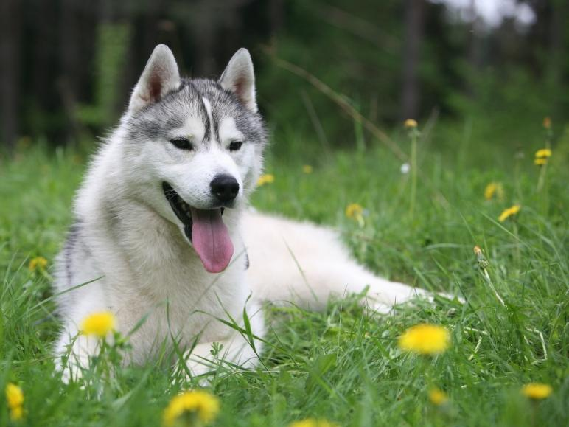
Dog Wisdom from the World around
Some Proverbs & Sayings
“In every country dogs bite.”
– English Proverb
"Every dog is allowed one bite.
" - US Proverb
"A good dog deserves a good bone.
" - US Proverb
“Take a dog for a companion and a stick in your hand.’ English Proverb
“Quarrelsome dogs get dirty coats. “ – English Proverb "A dog that runs after two bones catches neither." - English Proverb
"Do not respond to a barking dog." - Moroccan, Jewish saying
"Beware of a silent dog and still water." - Latin Proverb
"Children aren't dogs; adults aren't gods." - Haitian Proverb
"To live long, eat like a cat, drink like a dog." - German Proverb
"The barking of a dog does not disturb the man on a camel." - Egyptian Proverb
НАЗАД

Slide 7
Can You Answer PAGE
How much are you attentive?
Question #1
from three Friends:
"A good dog deserves a good …… .
" - US Proverb
phone |  | cone |  | bone |  | stone

Slide 8
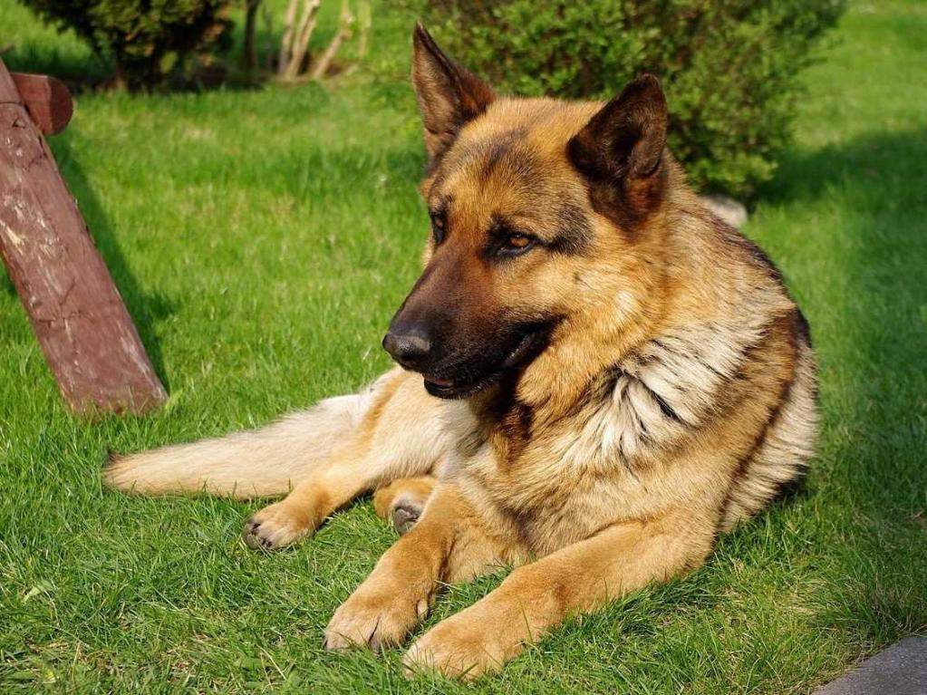
Here, the dog is alleged to have belonged to Llywelyn the Great, Prince of Gwynedd, a gift from King John of England. In this legend, Llywelyn returns from hunting to find his baby missing, the cradle overturned, and the dog with a blood-smeared mouth. Believing the dog savaged the child, Llywelyn draws his sword and kills it. After the dog's dying yelp Llywelyn hears the cries of the baby, unharmed under the cradle, along with a dead wolf which had attacked the child and been killed by Gelert. Llywelyn is then overcome with remorse and he buries the dog with great ceremony, yet he can still hear the dying yelp. After that day Llywelyn never smiles again.
A Real Story. Wales
A Real Story. Wales

Slide 9
Can You Answer PAGE
How much are you attentive?
Question #2
from three Friends:
Llywelyn draws his sword and ….. it.
pushes |  | kills |  | throws |  | hits

Slide 10
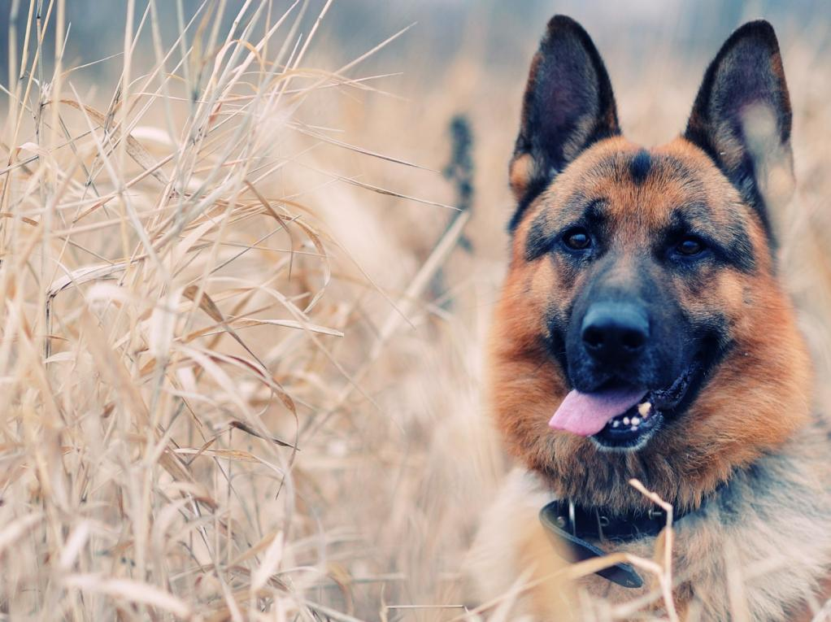
Poems Poems Poems
Dogs can be playful and run for a ball,
Dogs can be good and come when you call,
Dogs can be friendly when they wag their tail,
Dogs can be yucky when they sniff a snail,
Dogs can do chewing and bury a bone,
Dogs can be noisy and make Mummy groan,
Dogs can be dirty and covered in goo,
Dogs can be naughty and chew up your shoe.
Dogs can be fluffy and dogs can have spots,
Dogs can have some and dogs can have lots,
Dogs can be naughty and dogs can be good,
Dogs can do poop where never they should,
Dogs can be funny when they catch a fly,
Dogs can be greedy when they smell shepherds pie!
Dogs can be fun and dogs can be fine,
Dogs are best friends and I LOVE mine!
Poems Poems Poems
НАЗАД

Slide 11
Can You Answer PAGE
How much are you attentive?
Question #3
from three Friends:
Dogs can be friendly when they wag their tail,
Dogs can be yucky when they sniff a ….. .
mail |  | snail |  | nail |  | pail

Slide 12
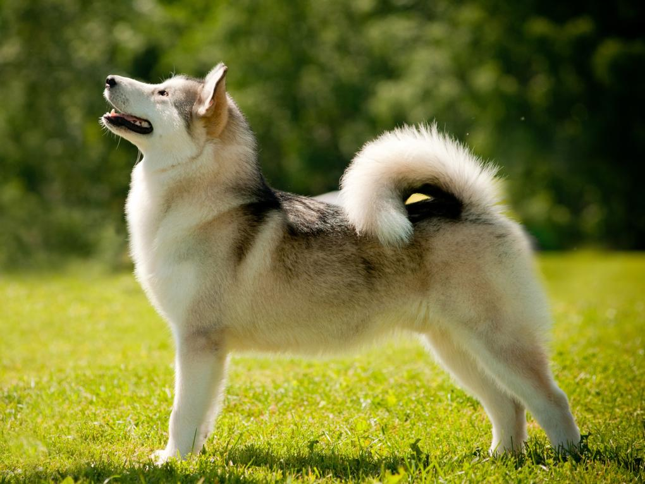
My Dog
By Karyn Jayne Sheeley,
USA
Champ’s my dog and he’s always in my heart, He loves me as well, and that’s the best part. Champ is exceptionally pleasant, he is rarely ever a pest, He's affectionate and loving, that’s what makes him the best. Wherever I go, no matter where I am, His love stays with me, his friendly self, gentle as a lamb. And when he dies, and leaves me behind, He will never be forgotten, since he was the pleasurable kind. Champ always has happiness to lend, And that’s what makes him my true best friend.
НАЗАД

Slide 13
Can You Answer PAGE
How much are you attentive?
Question #4
from three Friends:
Wherever I go, no matter where I am, His love stays with me, his friendly self, gentle as a …… .
lamb |  | ram |  | tram |  | pram

Slide 14
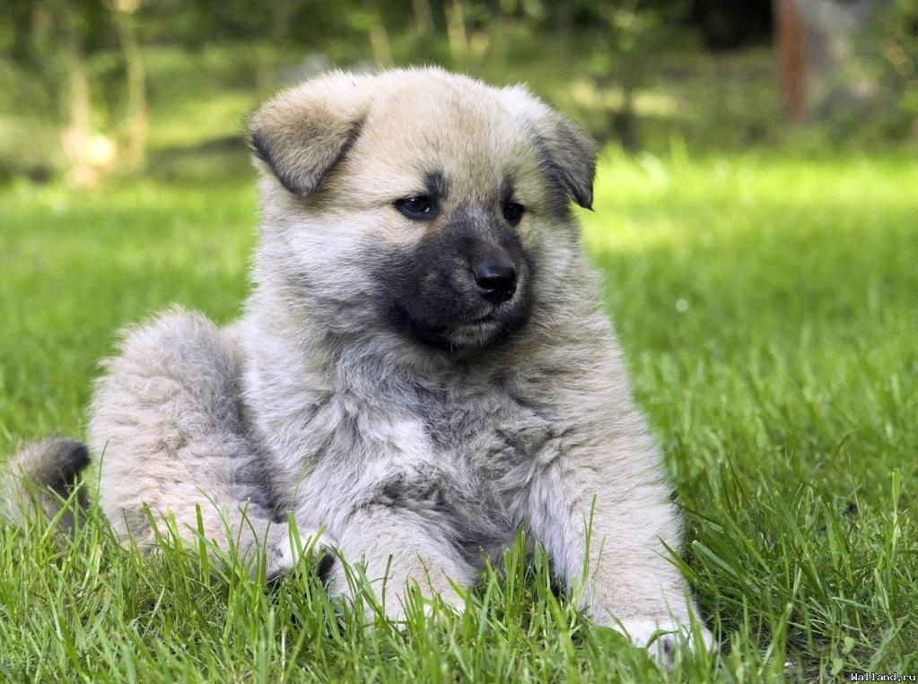
My Puppy Is A Handful
by Ann Davies
My puppy is a handful, So full of energy, She jumps around to greet us, And wags her tail with glee.
She digs when in the garden, Getting muddy from her head to her toes, Whatever goes on in her mind, Heaven only knows!

Slide 15
Can You Answer PAGE
How much are you attentive?
Question #5
from three Friends:
My puppy is a handful, So full of energy, She jumps around to greet us, And wags her tail with ……. .
tea |  | pea |  | bee |  | glee

Slide 16
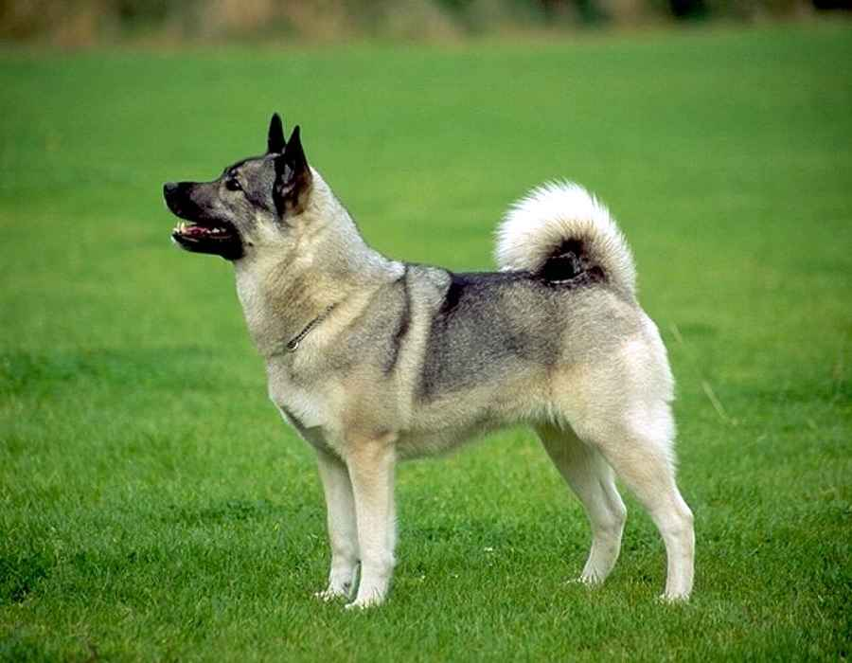
My Best Friend
by Abby Jenkins
Loves his ball it's his favorite thing What's most fun for him? Everything! Great big tongue that licks my face Has a crate his very own space. Big brown eyes like moon pies He's my friend till the very end!
Black and White Thick and furry Fast as the wind Always in a hurry Couple of spots Rub my ears Always comes his name he hears!
НАЗАД

Slide 17
Can You Answer PAGE
How much are you attentive?
Question #6
from three Friends:
Great big tongue that licks my face, Has a crate his very own ….. .
space |  | lace |  | trace |  | place

Slide 18
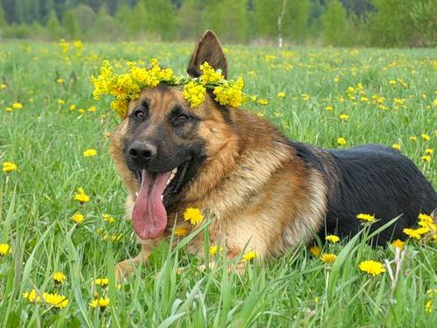
Dog And Me by Emily Guthrie
I only have a group of three, me, my dog, my dog and me
It's a lonely way to be, me, my dog, my dog and me We are a safe with no key, me, my dog, my dog and me Three to talk to two to see, me, my dog, my dog, and me

Slide 19
Can You Answer PAGE
How much are you attentive?
Question #7
from three Friends:
I only have a group of ….. , me, my dog, my dog and me
tree |  | three |  | key |  | glee

Slide 20
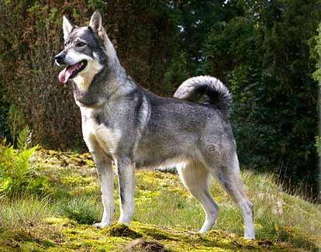
Dogs are more than pets, they’re companions
There is nothing quite as cute as a puppy Dogs are fiercely loyal Dogs are great listeners Dogs do not judge their masters Dogs are grateful for any food fed them Dogs are ready to play anytime
Dogs can be trained to carry, guide, search, rescue and hunt Dogs protect life & property, even to their own demise
Dogs are 'Man’s best friend'
After all, God is Dog spelled
backwards...
Ray Lucero
ДАЛЕЕ

Slide 21
Can You Answer PAGE
How much are you attentive?
Question #8
from three Friends:
Dogs do not ….. their masters
judge |  | listen |  | like |  | punish

Slide 22
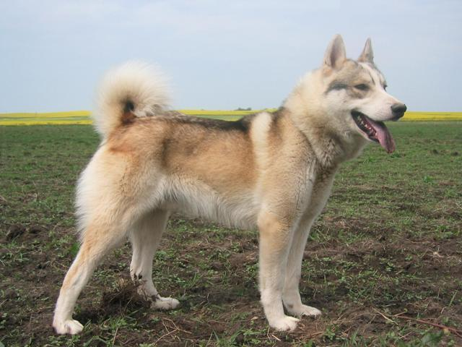
Dogs & Superstitions
It is good luck for dogs to come to your house.
Howling dogs are a sign of bad luck or illness.
Dogs age 7 years for every human year. Contrary to popular belief, there is no exact formula to gauge how much a dog ages – it's as individual for dogs as it is for people. But a rough guide is thus: The first year of a dog's life is equivalent to 16 human years. After 2 years, they are the equivalent of a 24-year-old. At 3 years, they are the equivalent of a 30-year-old. Each year after, add 5 human years to determine your dog's age. This is a rough guide, however.
ДАЛЕЕ

Slide 23
Can You Answer PAGE
How much are you attentive?
Question #9
from three Friends:
At 3 years, they are the equivalent of a ….. -year-old man.
20 |  | 13 |  | 33 |  | 30

Slide 24
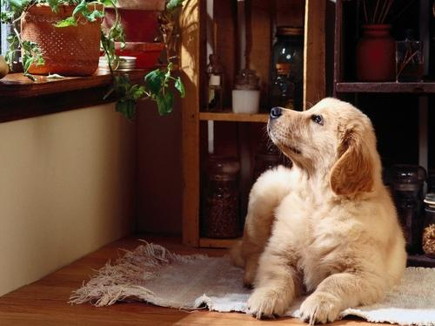
Some interesting Facts
- There are more than 150 dog breeds, divided into 8 classes: sporting, hound, working, terrier, toy, non-sporting, herding, and miscellaneous.
Some Interesting Facts

Slide 25
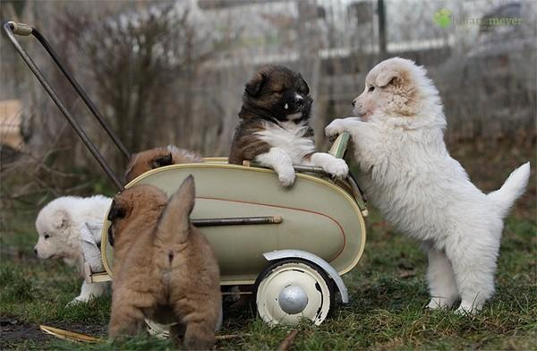
Some interesting Facts
The Labrador Retriever is the #1 favorite breed in the U.S., Canada, and the U.K.
President Lyndon Johnson had two beagles named Him and Her
Teddy Roosevelt's dog, Pete, ripped a French ambassador's pants off at the White House.
The U.S. has the highest dog population
in the world.
Franklin Roosevelt spent $15,000 for a destroyer to pick up his Scottie in the Aleutian Islands.
George Washington had thirty-six dogs - all foxhounds - with one-named Sweet lips.
Three dogs survived the sinking of the Titanic - a Newfoundland, a Pomeranian, and a Pekingese.
Some interesting Facts

Slide 26
Can You Answer PAGE
How much are you attentive?
Question #10
from three Friends:
George Washington had …… dogs - all foxhounds - with one-named Sweet lips.
16 |  | 26 |  | 36 |  | 60

Slide 27
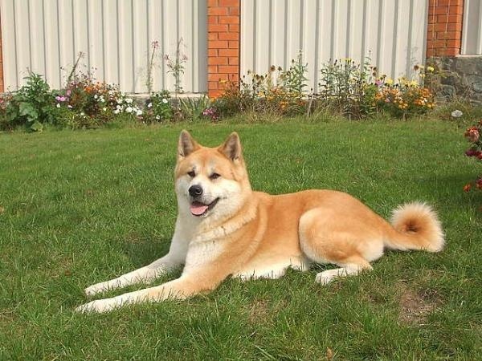
Have you ever heard about Hachiko?
Hachiko:
A Dog's Story
How boundless could be a dog's love
to its master?

Slide 28
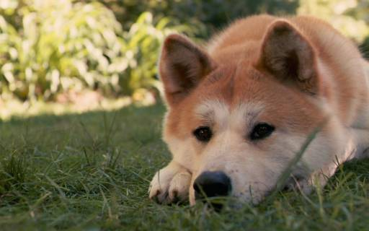
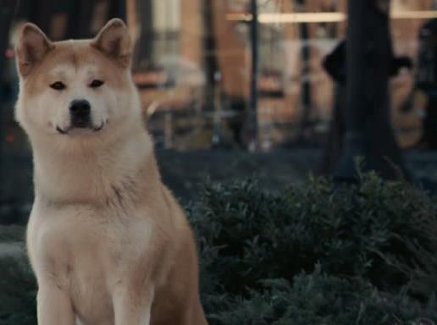
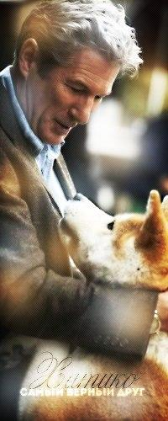
Hachiko is the film worth to be seen
Lasse Hallström,
a director from the movie "Hachiko:
A Dog's Story" wants to show us a breathtaking, true story about love, loyalty, friendship and longing.

Slide 29
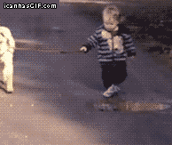
Three Friends
PAGE
A Tiny Video Clip for you
with Love
Be creative. Make up a story
about the boy and the dog.
Whose story will be Number 1 !

Slide 30
Three Friends
PAGE
Well, who is a winner today?
We are sending you an Extra Five! “5”!
Have you got it?
Good Luck!
Bye!

Slide 31
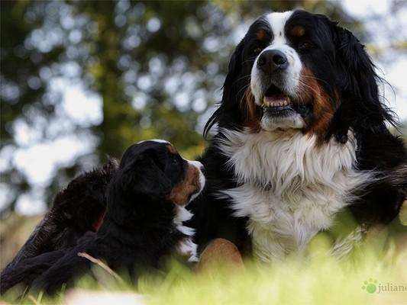
All the Information and all the pictures were taken from the Internet

Slide 32
Thank you for being with us!
See you!

Slide 33
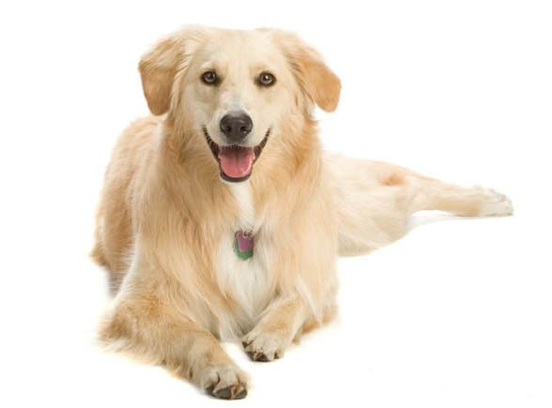
SOURCES
http://en.wikipedia.org/wiki/Dog
http://visual.merriam-webster.com/animal-kingdom/carnivorous-mammals/dog/morphology-dog_1.php
http://dogpic.com.ua/category/krasivye-sobaki/
http://www.businessinsider.com/the-11-best-dog-breeds-of-all-time-2013-8
http://commons.wikimedia.org/wiki/File:Anatolian_shepherd_dog.jpg
http://www.special-dictionary.com/proverbs/keywords/dogs/
http://en.wikipedia.org/wiki/Gelert
http://adinah.hubpages.com/hub/Dog-Poems-for-Children
http://www.voicesnet.org/displayonepoem.aspx?poemid=53464
http://www.familyfriendpoems.com/poem/my-puppy-is-a-handful
http://www.familyfriendpoems.com/poems/friend/pet/
http://www.petfinder.com/dogs/bringing-a-dog-home/facts-about-new-dog/
http://www.yolfercanijosconencanto.com/index.html?body19.html

