Slide 1
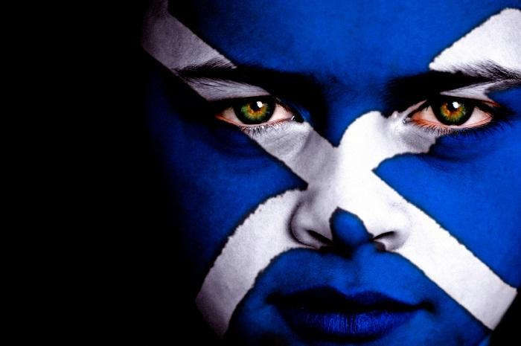
Scottish independence: myth or reality?
Презентация
на тему:
«Шотландская независимость: миф или реальность»
Выполнила:
Жаркова Наталия Владимировна
студентка 3-го курса специальность
« Экономика и бухгалтерский учет» (по отраслям)
ГАПОУ Саратовской области "Сельскохозяйственный техникум им.К.А.Тимирязева»
Руководитель: Шлеина И.И.

Slide 2
Scottish independence: myth or reality?
General information;
Wars of Scottish Independence;
the Scots National League 1921;
Scotland Act 1978;
Scottish devolution referendum, 1997;
Scottish independence referendum, 2014.

Slide 3
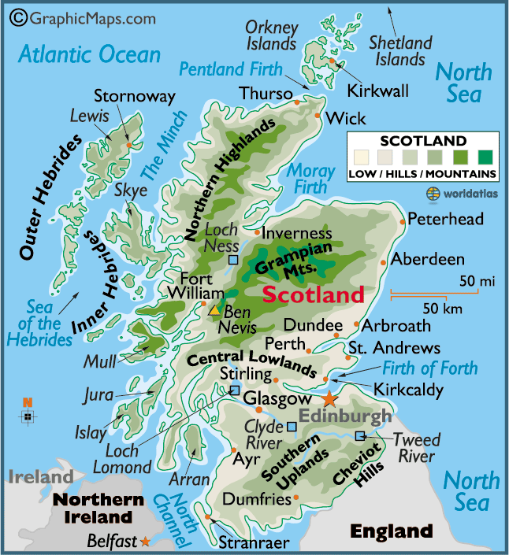
Scotland is a country that is part of the United Kingdom of Great Britain and Northern Ireland

Slide 4
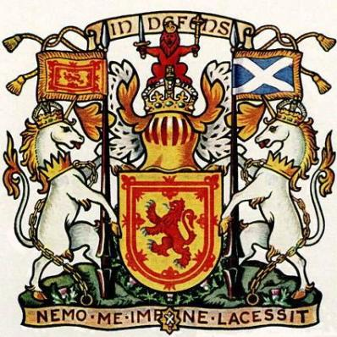
Scotland
Capital - Edinburgh
Area – Total 78,387 km²
Population - 5,313,600

Slide 5
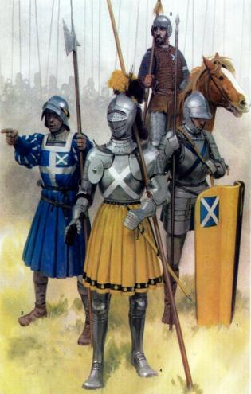
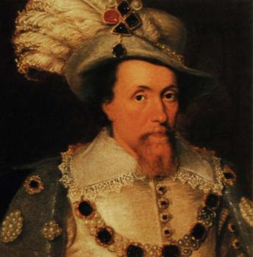
Motto: "In My Defens God Me Defend" (Scots) "In my defence God me defend" (Eng)
The Kingdom of Scotland emerged as an independent sovereign state in the Early Middle Ages and continued to exist until 1707.

Slide 6
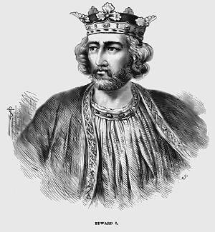
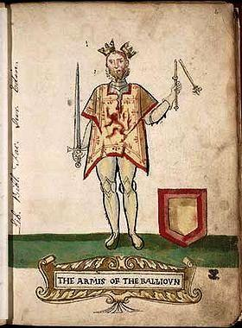
Wars of Scottish Independence
The First War (1296–1328) began with the English invasion of Scotland in 1296, and ended with the signing of the Treaty of Edinburgh-Northampton in 1328.

Slide 7
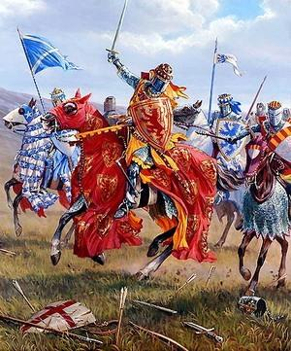
Wars of Scottish Independence
The Second War (1332–1357) began with the English-supported invasion by Edward Balliol and the "Disinherited" in 1332, and ended in 1357 with the signing of the Treaty of Berwick.

Slide 8
The twentieth century
In 1921, influenced by Sinn Fein, the Scots National League was formed as a body, primarily based in London, seeking Scottish independence.

Slide 9
Scotland Act 1978
The Scotland Act 1978 was an Act of the Parliament of the United Kingdom intended to establish a Scottish Assembly as a devolved legislature for Scotland. At a referendum held in the following year, the Act failed to gain the necessary level, and was never put into effect.

Slide 10
Scottish devolution referendum, 1997
The Scottish devolution referendum of 1997 was a pre-legislative
held in Scotland on 11 September 1997 over whether there was support for the creation of a Scottish Parliament with devolved powers, and whether the Parliament should have tax-varying powers.

Slide 11
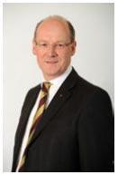
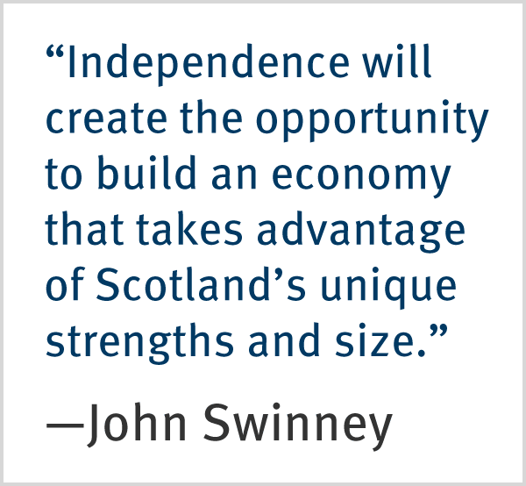
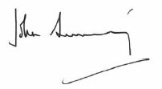
«Scotland is a wealthy nation. Whether through the talents of our people or the natural resources of our country there is no doubt that Scotland has the potential to be a successful independent nation.» John Swinney MSP

Slide 12
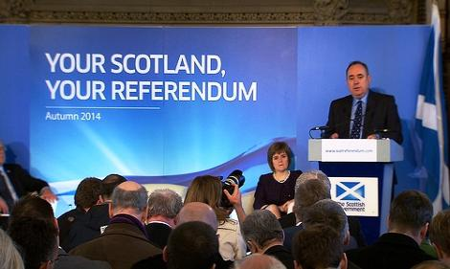
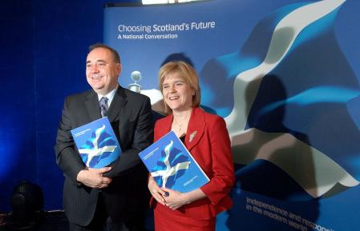
Scottish independence referendum, 2014
A referendum on whether Scotland should be an independent country will take place on Thursday 18 September 2014.

Slide 13
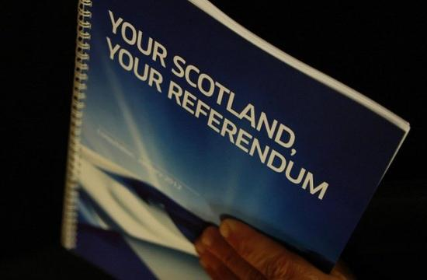
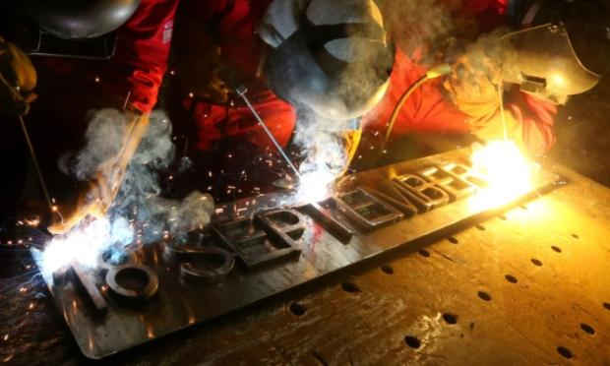

Slide 14
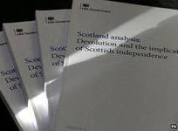
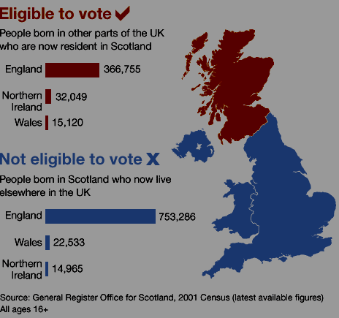

Slide 15
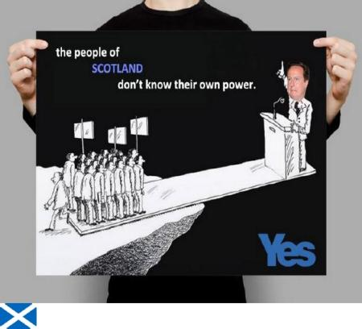
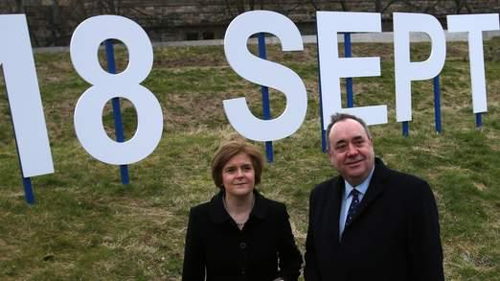
Scottish independence For or Against?

Slide 16
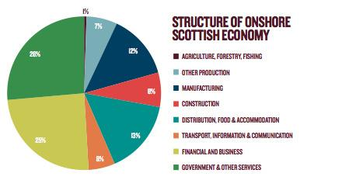
The argument for .............
9 key economic facts that prove Scotland will be a wealthy independent nation.
Scotland has a rich and diverse economy;
Scotland is a net contributor to the UK;
Scotland generates far more tax than the UK average;
Westminster has cost Scotland £64 billion in the past 30 years.

Slide 17
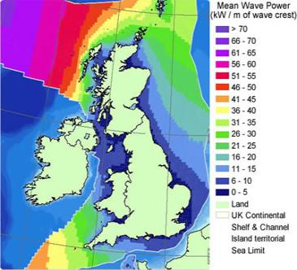
Scotland has strong exports;
Scotland’s oil fields remain a massive financial asset;
Scotland has huge potential in renewable energy;
Scotland is one of the top UK locations for inward investment;
An independent Scotland can support Scottish business in tax, regulation, the labour market, innovation and global exports.

Slide 18
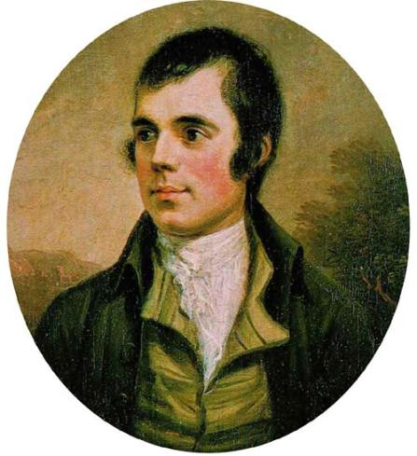
“We will drain our
dearest veins, but they shall be free”

Slide 19
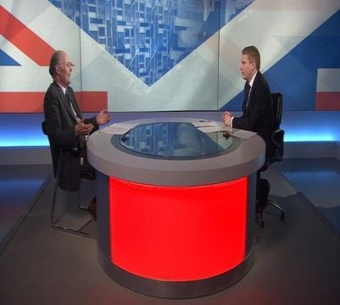
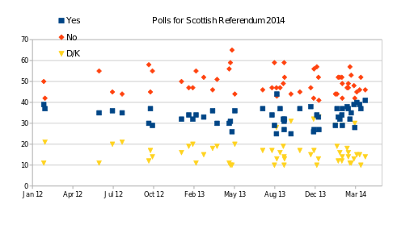
Professor John Curtice stated in January 2012 that polling showed support for independence at between 32% and 38% of the Scottish population.

Slide 20
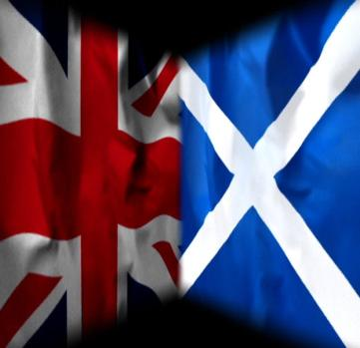
The argument against .............
Much of the desire for Scottish independence is based on a romanticized idea of Scottish history and legend.
Now and in the future Scotland is stronger as part of the United Kingdom and the United Kingdom is stronger with Scotland as a partner. Working together, better together.

Slide 21
5 Reasons Why Scottish Independence Would Be An Economic Disaster. David Nicholson.
Currency confusion.
Delusions of oil grandeur.
Financial mismanagement.
Loss of credibility.
Lack of natural resources.

Slide 22
Should Scotland be an independent country?

Slide 23
Используемая литература:
Восковская А.С., Карпова Т.А. Английский язык для средних специальных учебных заведений. – Ростов н/Д: изд-во «Феникс», 2003.
Агабекян И.П. Английский для средних специальных заведений. Серия «Среднее профессиональное образование» Ростов н/Д: «Феникс», 2004.
http://www.gloscol.ac.uk/
http://www.forbes.com/
http://www.scotland.gov.uk/
http://en.wikipedia.org/

